Slide 1



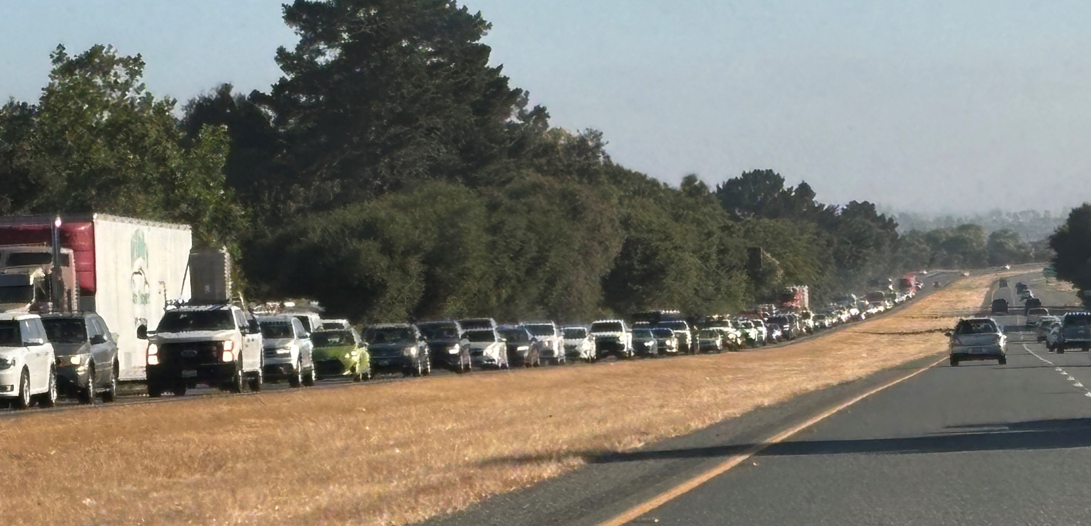
SR 68 Corridor Update
Doug Bilse, TE
Project Manager
Notes:
How many were here October 8?
Review attendance dots

Slide 2
What’s New on SR 68?
Long-Term Project Report (Roundabouts)
Pilot Project for Adaptive (AI) Signal Operations
Completed Pilot Project for Toro Park
Comprehensive Multimodal Corridor Study

Slide 3
Scenic Route 68 Corridor Improvement Project
Draft Environmental Document: Fall 2024
  Hybrid roundabouts for all intersections
First phase
  San Benancio, Corral de Tierra and Laureles Grade
  Wildlife crossings & Bike facility along shoulders
  Toro park improvements
Final Environmental Report due this summer
  Represents formal approval of project by Caltrans
Final design of first phase
  Done by Summer 2026 for next grant cycle

Slide 4
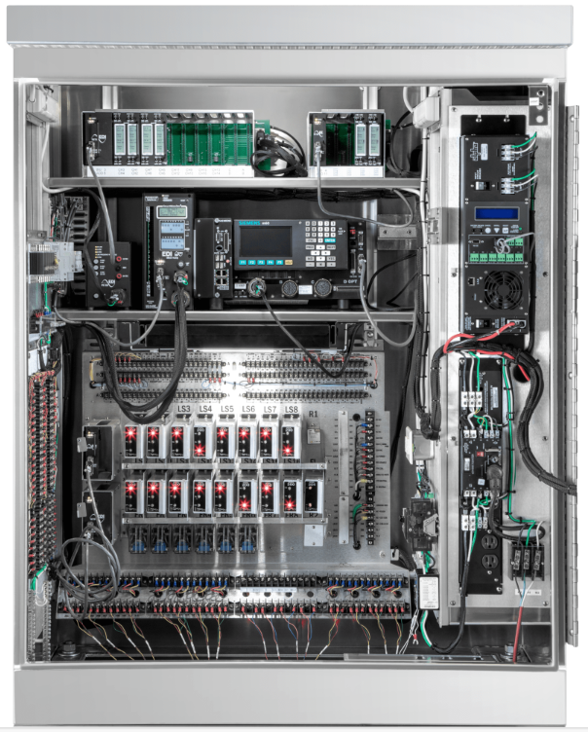
Pilot Project for Adaptive (AI) Signal Operations

Slide 5
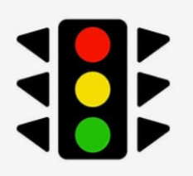
Types of Traffic Signal Operation
Free (Uncoordinated)
Traffic served in specific sequence
Treats everyone equally
Very efficient (least lost time)
Coordinated
Specific schedule for specific timeframe
Serve side streets then “rest” on mainline green
One direction of mainline travel prioritized
Inefficient/unused green time
Adaptive (AI)
Hybrid of Free and Coordinated modes
Switches as needed to best serve current conditions
Uses real-time information to quickly adapt to field conditions
Reduced unused green time

Slide 6
Traffic Signals:
Comparing Modes of Operations
Condition | Free (uncoordinated) | Coordinated | Adaptive
Off-Peak / Light Traffic | Great | Poor | Good
Peak Hour / Heavy Traffic | Poor | Great | Great
Incident | Good | Poor | Great
Special Event | Fair | Poor | Great
Close Intersections | Poor | Good | Great
Signals Spaced Far Apart | Good | Poor | Fair

Slide 7
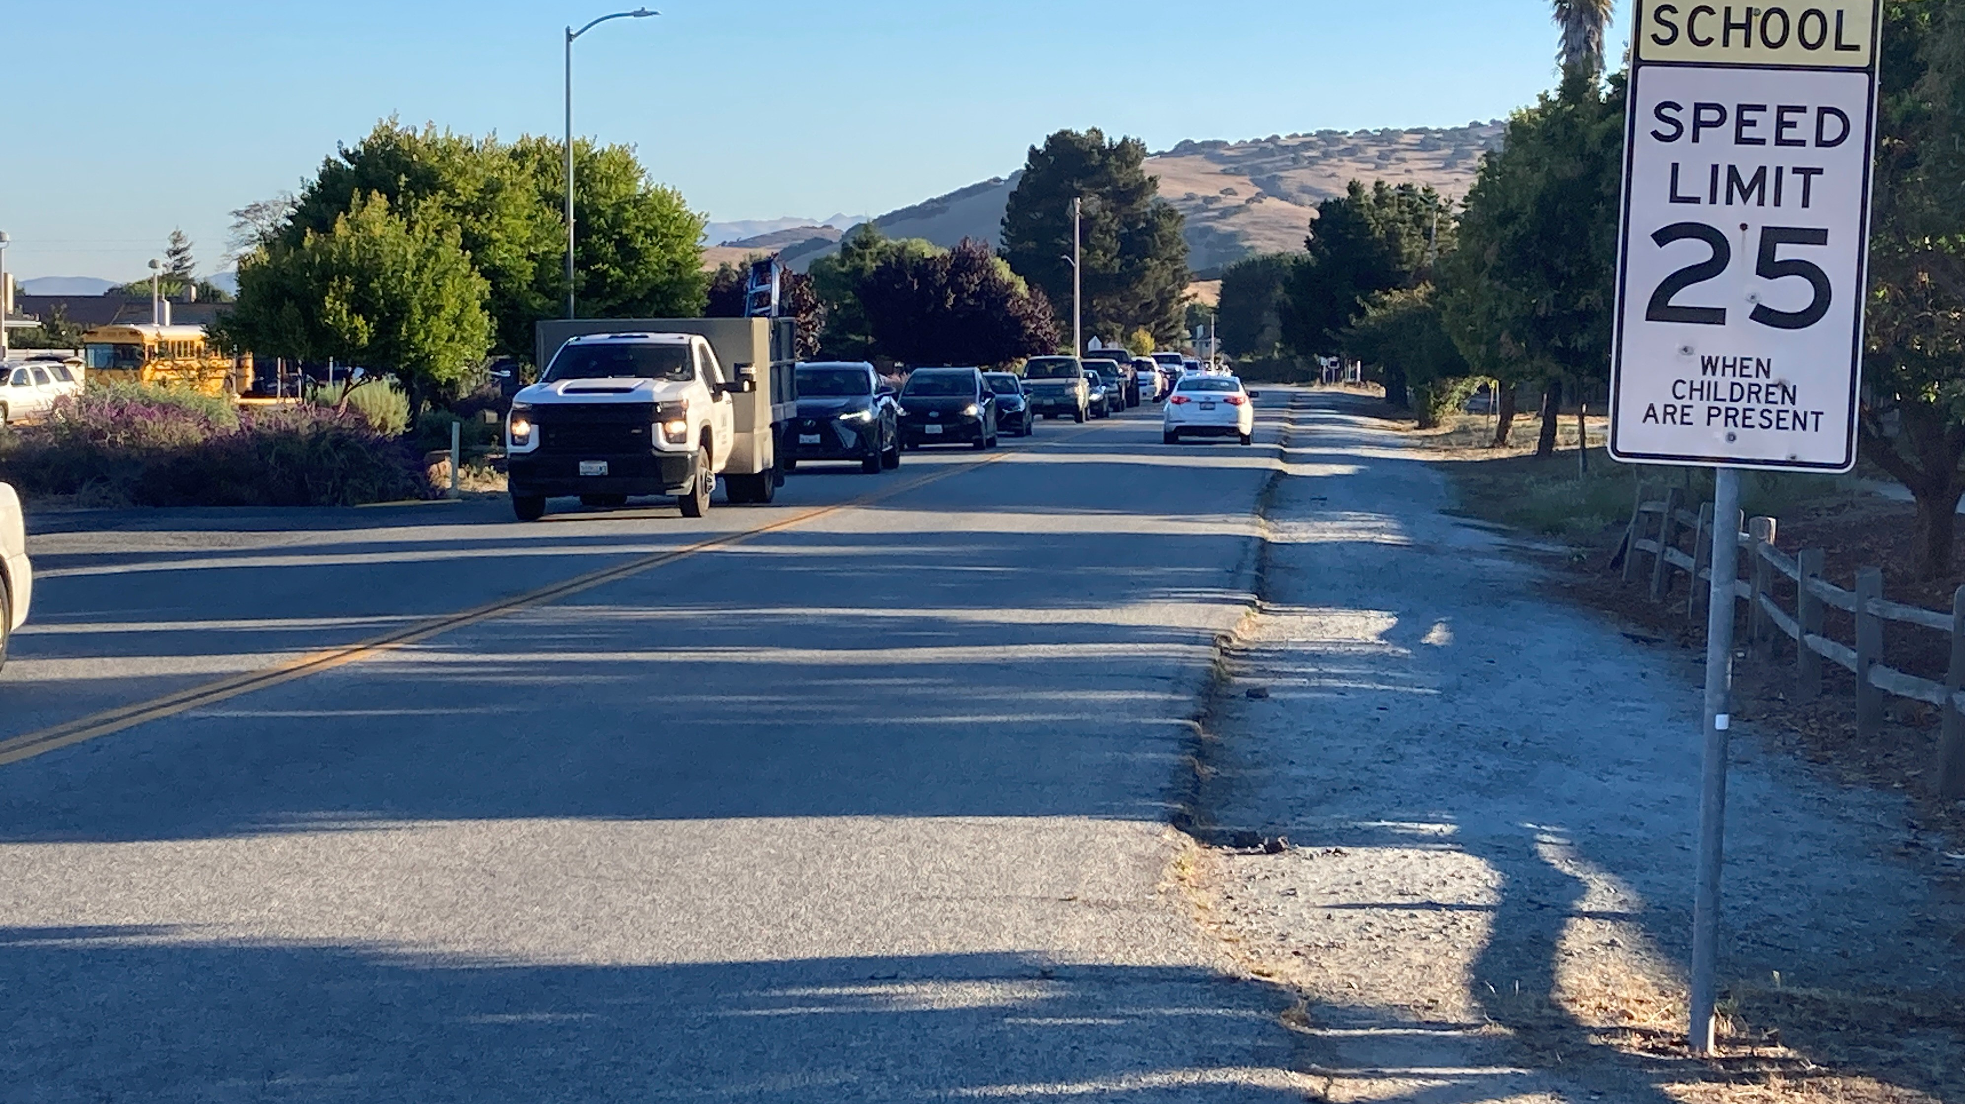
Toro Park
Cut-Through Traffic

Slide 8
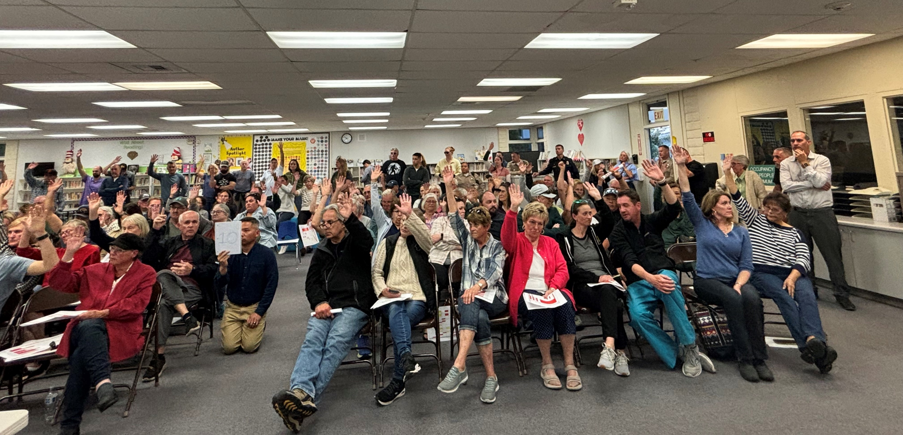
Pilot Project Completed
County Project Now

Slide 9
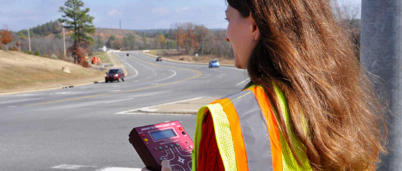
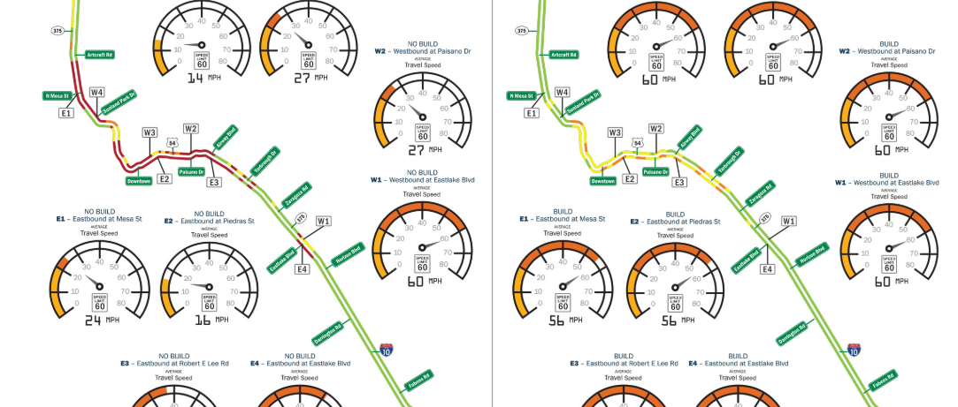
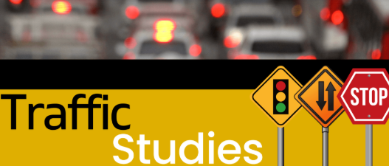
Comprehensive Multimodal Corridor Study
Make informed decision on future projects for corridor
Unbiased assessment
  Baseline conditions: AI Signals
  Future scenario: Roundabouts
Transparency
  Real-time monitoring data on project website
  3rd-Party Validation
Community Engagement

Slide 10
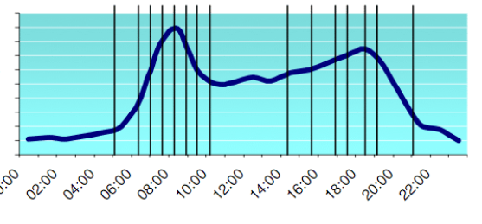
Most Representative Monitoring: Travel Time

Slide 11
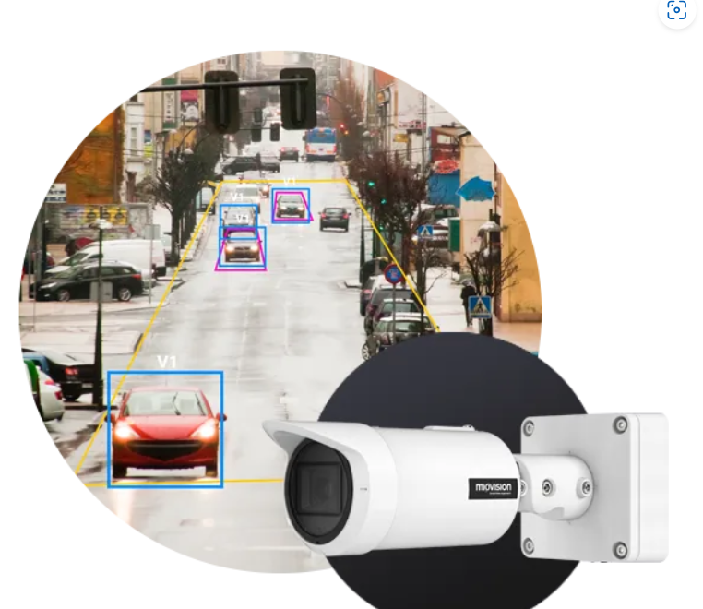
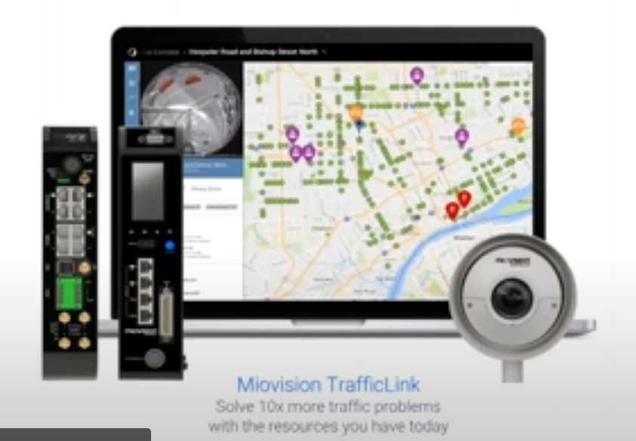
Travel Time Monitoring

Slide 12
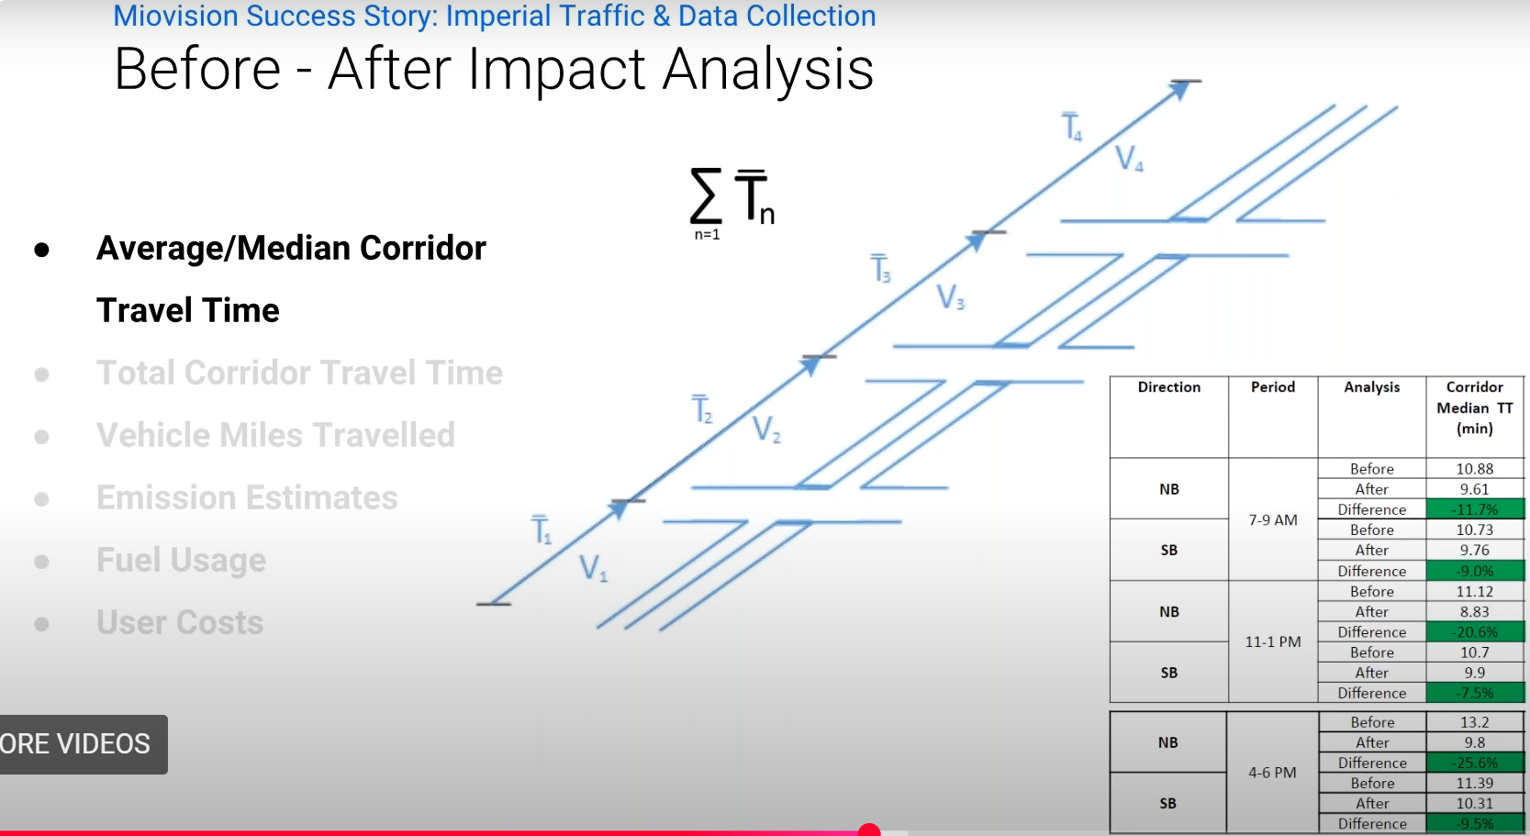
Most Representative Monitoring: Travel Time

Slide 13
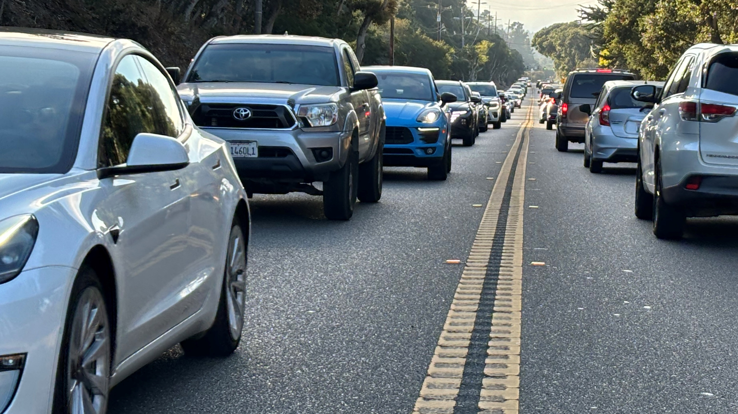
Questions

Slide 14
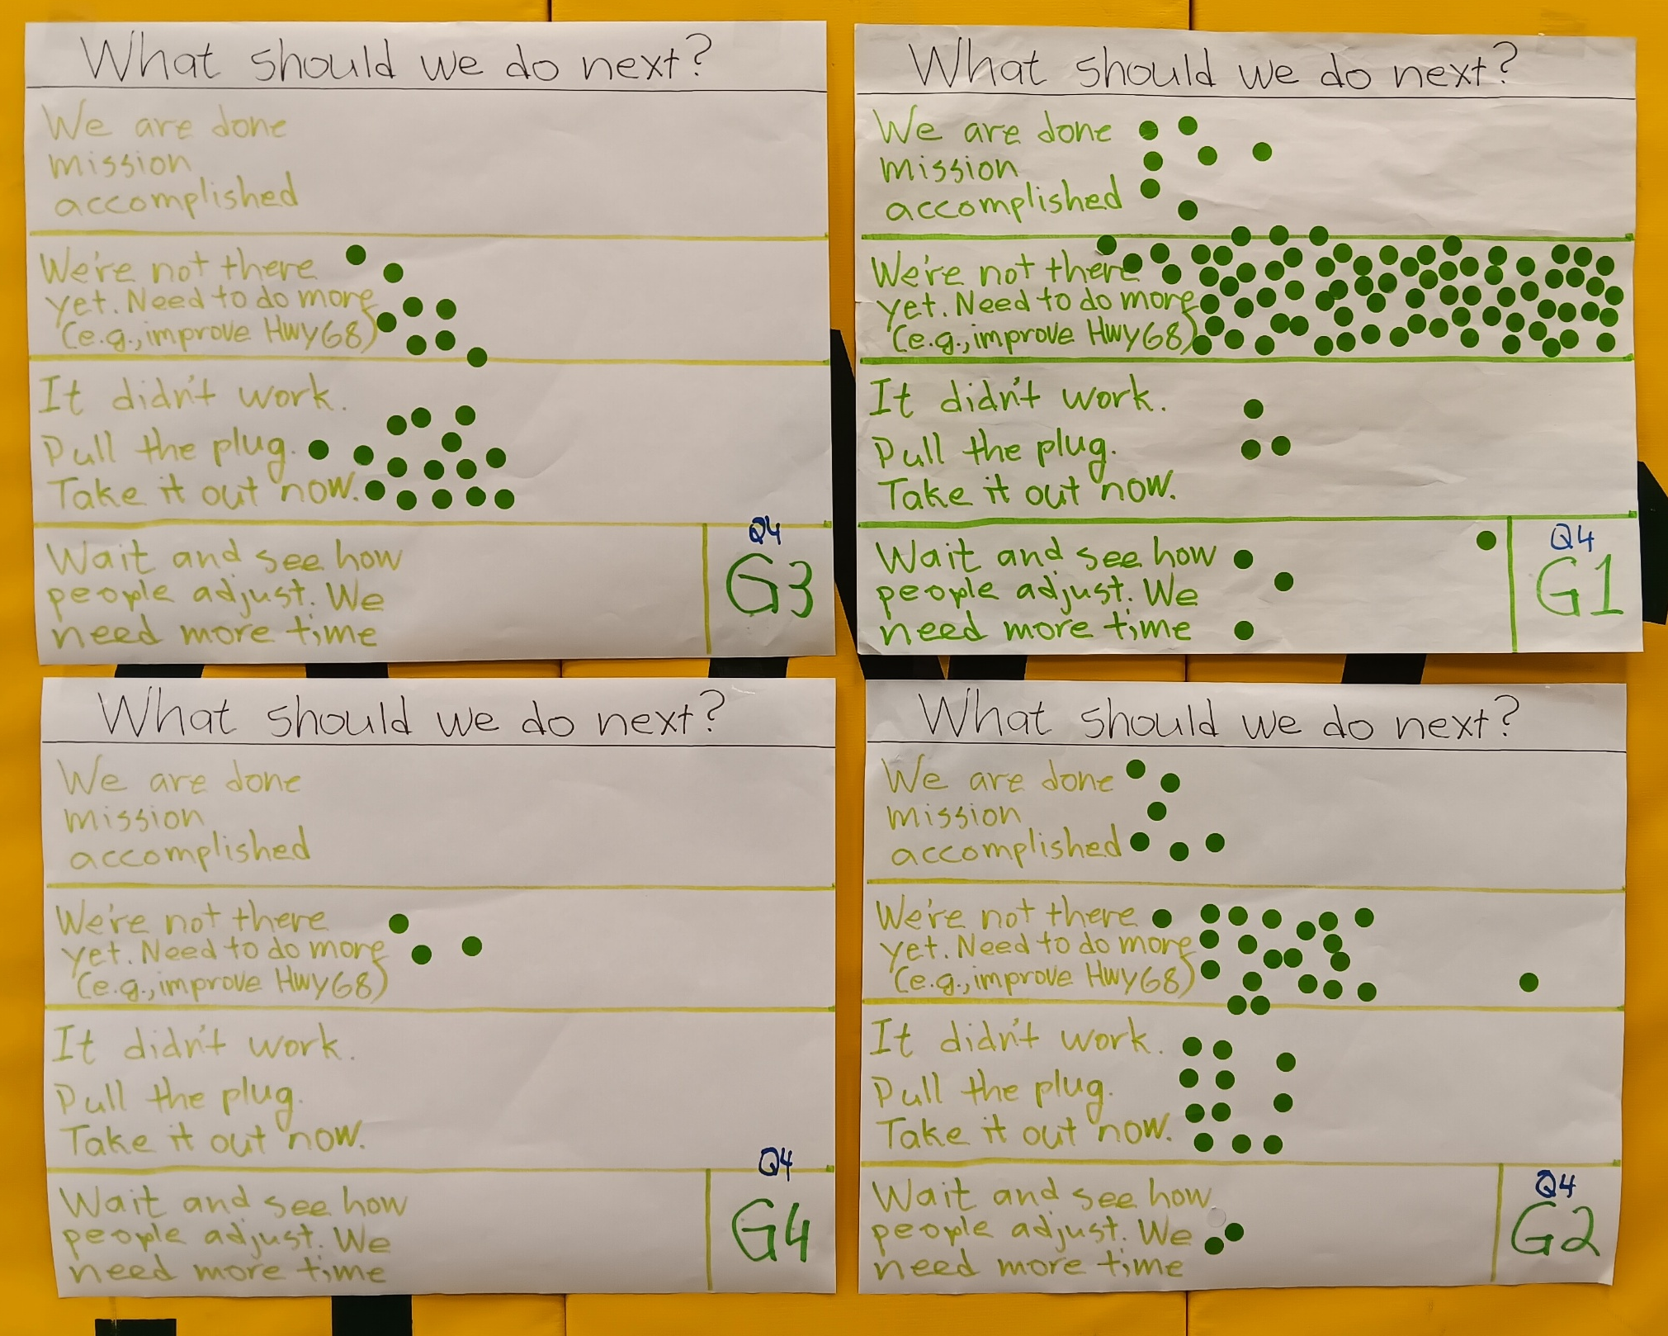
October 8 Community Workshop Results

Slide 15

We Heard You Loud and Clear!
Phase I doesn’t work for West Toro or school
Phase II is too close to Creekside residences
Congestion limited to a few hours- solution should be too!
Fund permanent improvements
Make it look nice
Notes:
How can we do better?

Slide 16
January 15 Workshop Results
Torero Drive Partial Road Closure
Relocate closure to School Entrance:
 | All | 64%
 | West Toro Park | 70%
Install gates when possible:
 | All | 85%
 | West Toro Park | 75%
Remove road closures/Kill project:
 | All | 8%
 | West Toro Park | 16%

Slide 17
January 15 Workshop Results
Creekside Partial Road Closure
Relocate closure to School Entrance: 89%
Install gates when possible: 82%
Remove closures/Kill project: 10%

Slide 18

How do we fund this?
Include safe routes to school features
Include multimodal path
Tie improvements into State Route 68 Roundabout Project
Notes:
New years resolution
Make good decisions quickly
Dry January

Slide 19
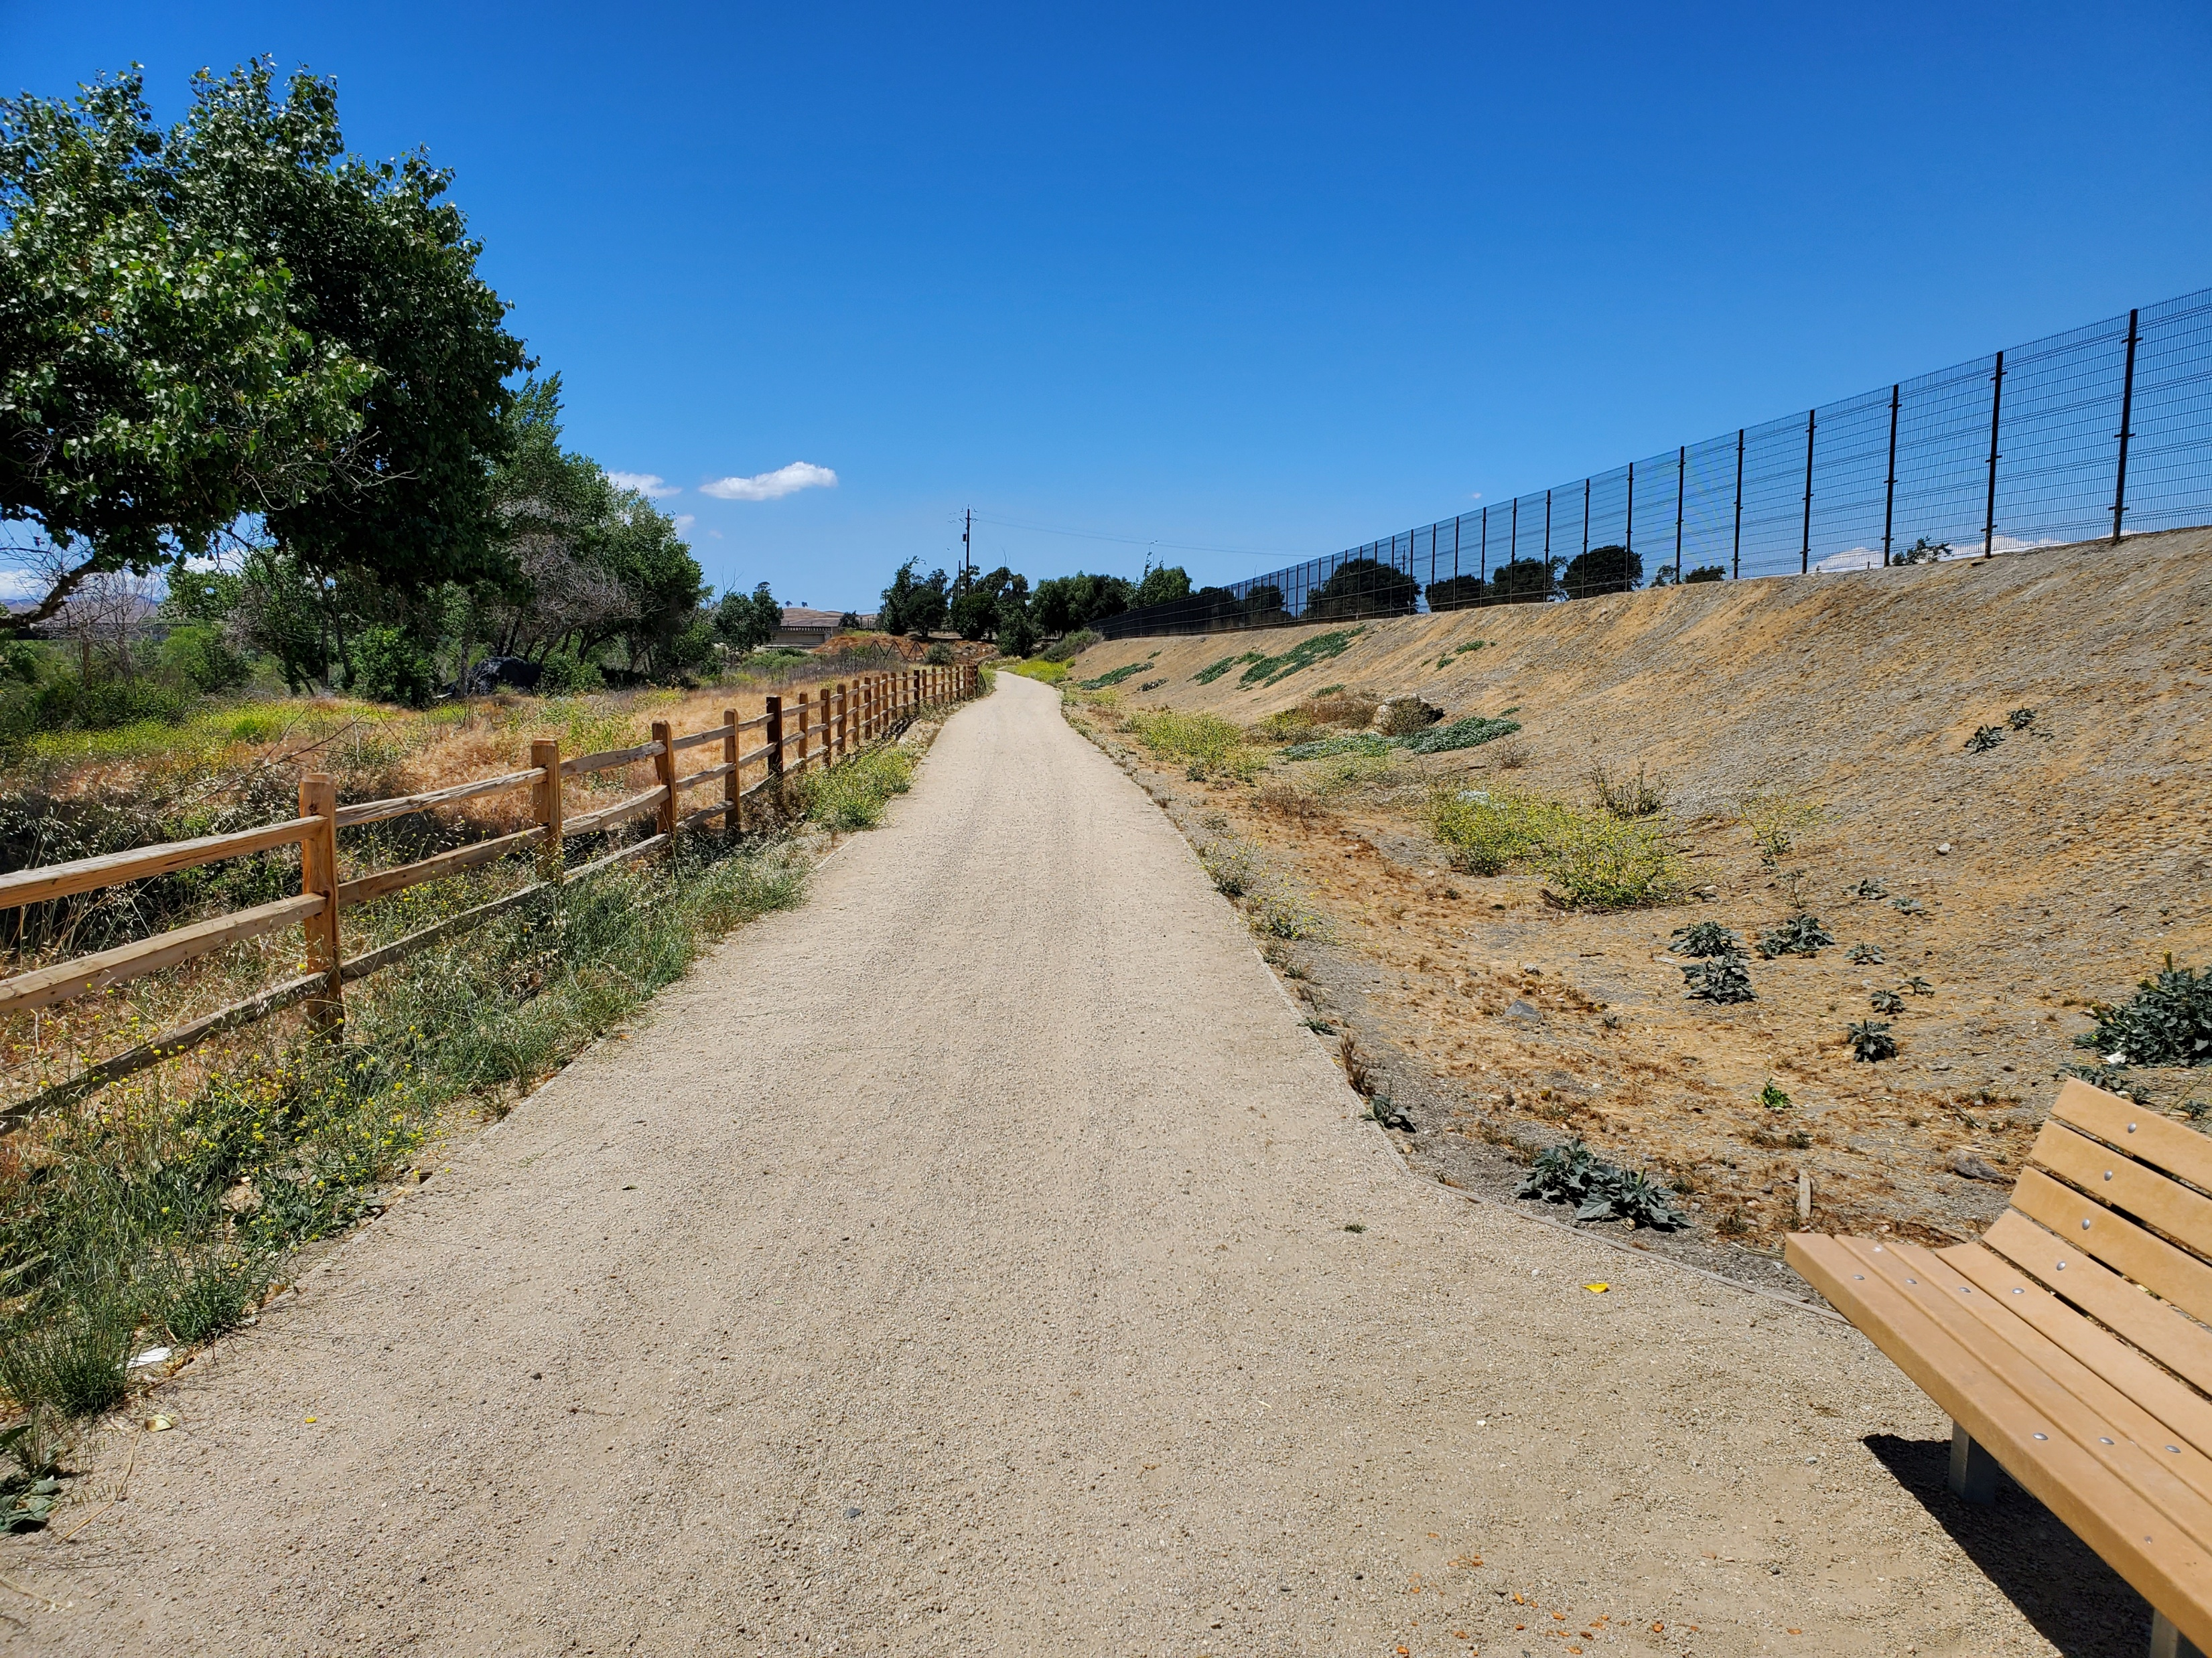
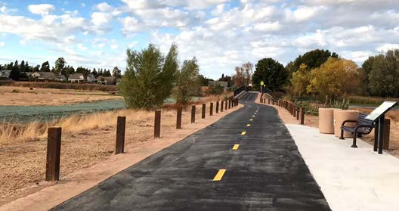
Multi-Use Path

