Slide 1



measure x priority projects
CORRIDOR ADVISOR update may 24, 2023

Slide 2

CORRIDOR ADVISOR ROLE
Assess and Advise the Delivery of Priority State Highway Improvement Projects that use Measure X funds:
  State Route 68 Scenic Highway
  US 101 South of Salinas
  State Route 156 West
Evaluate Project Delivery Schedules and Develop Implementation and Funding Strategies.
Coordinate with Caltrans, TAMC, and others to facilitate Project Implementation and Funding.

Slide 3

  Community Outreach Event
    July 19, 2023 - 4:30 pm to 7:30 pm
    WeatherTech Raceway Laguna Seca
  Event Objectives
    Provide Update on Project Delivery
    Review the Project’s Purpose and Need
    Review Alternatives
    Share Opportunities for Public and Stakeholders to Provide Input

Slide 4
NEED
  Congestion causing Traffic Delays and unreliable Travel Times
  Collisions Rates above the Statewide Average for a Similar Roadway
    Rear-end Collisions typically caused by long queues
  Wildlife barrier between Fort Ord National Monument & Los Padres National Forrest.
PURPOSE
  Improve Traffic Flow throughout the Corridor
  Address Safety by Reducing the Rate and Severity of Collisions
  Enhance Wildlife Connectivity & Reduce Wildlife / Vehicles Collisions
  Improve Bicycle & Pedestrian Access at the Intersections

Slide 6
Stages to Delivering Projects
Right of Way and Permits
Assess
Needs & Constraints
Identify Viable Concepts
Construction
Env. Review
Alternative Selected
Design
Today
Public Input and Feedback
Secure Funding

Slide 7
ALTERNATIVES
UNDER CONSIDERATION
Roundabouts
Convert up to 9 Intersections to Roundabouts
5 Wildlife Crossings Improvements
Traffic Signals
Traffic Signals with Through & Turning lanes at 9 Intersections
5 Wildlife Crossings Improvements

Slide 8
ALTERNATIVES
NO LONGER UNDER CONSIDERATION
  Full Corridor Widening
  Bypass (Full Bypass and Corral de Tierra Bypass)
  Managed Lanes (Bi-Directional Peak Period Lane)

Slide 9
SCHEDULE
  Draft Environmental Document Release September 2023
  Project Approval & Environmental Document Completion Fall 2024
  Right of Way Completion Winter 2025
  Design & Permitting Completion Summer 2027
  Begin Construction (subject to funding) Winter 2028
  End Construction Fall 2029
  Improvements Could Be Completed in Phases

Slide 10
PRELIMINARY COST ESTMATE
Total Project Cost - $ 150 M to $ 215 M
POTENTIAL FUNDING SOURCES
Measure X
State Transportation Improvement Program (STIP)
State Highway Operations Protection Program (SHOPP)
Senate Bill 1 (SB 1)*
  Solutions for Congestion Corridors (SCCP)
  Local Partnership Program (LPP)
    *Applications Submittal Fall 2024

Slide 11
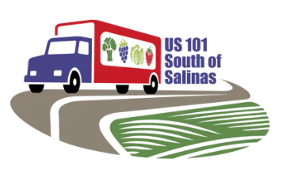
PROJECT GOALS
Reduce Fatalities and Severe Injuries.
Define Solutions that Align with Transportation Policies, Support Economic Prosperity, and Enhance the Communities.
Use Community Engagement to keep Stakeholders Informed and Build Consensus.
Strive to complete Environmental Phase to pursue Funding in next SB 1 funding cycle (Fall 2024).

Slide 12
PROJECT GOALS (continued)
Evaluate Opportunities to Design and Construct Phases as Funding is obtained
Evaluate Alternative Project Delivery Methods to Facilitate Constructability and reduce Impacts during Construction.

Slide 13
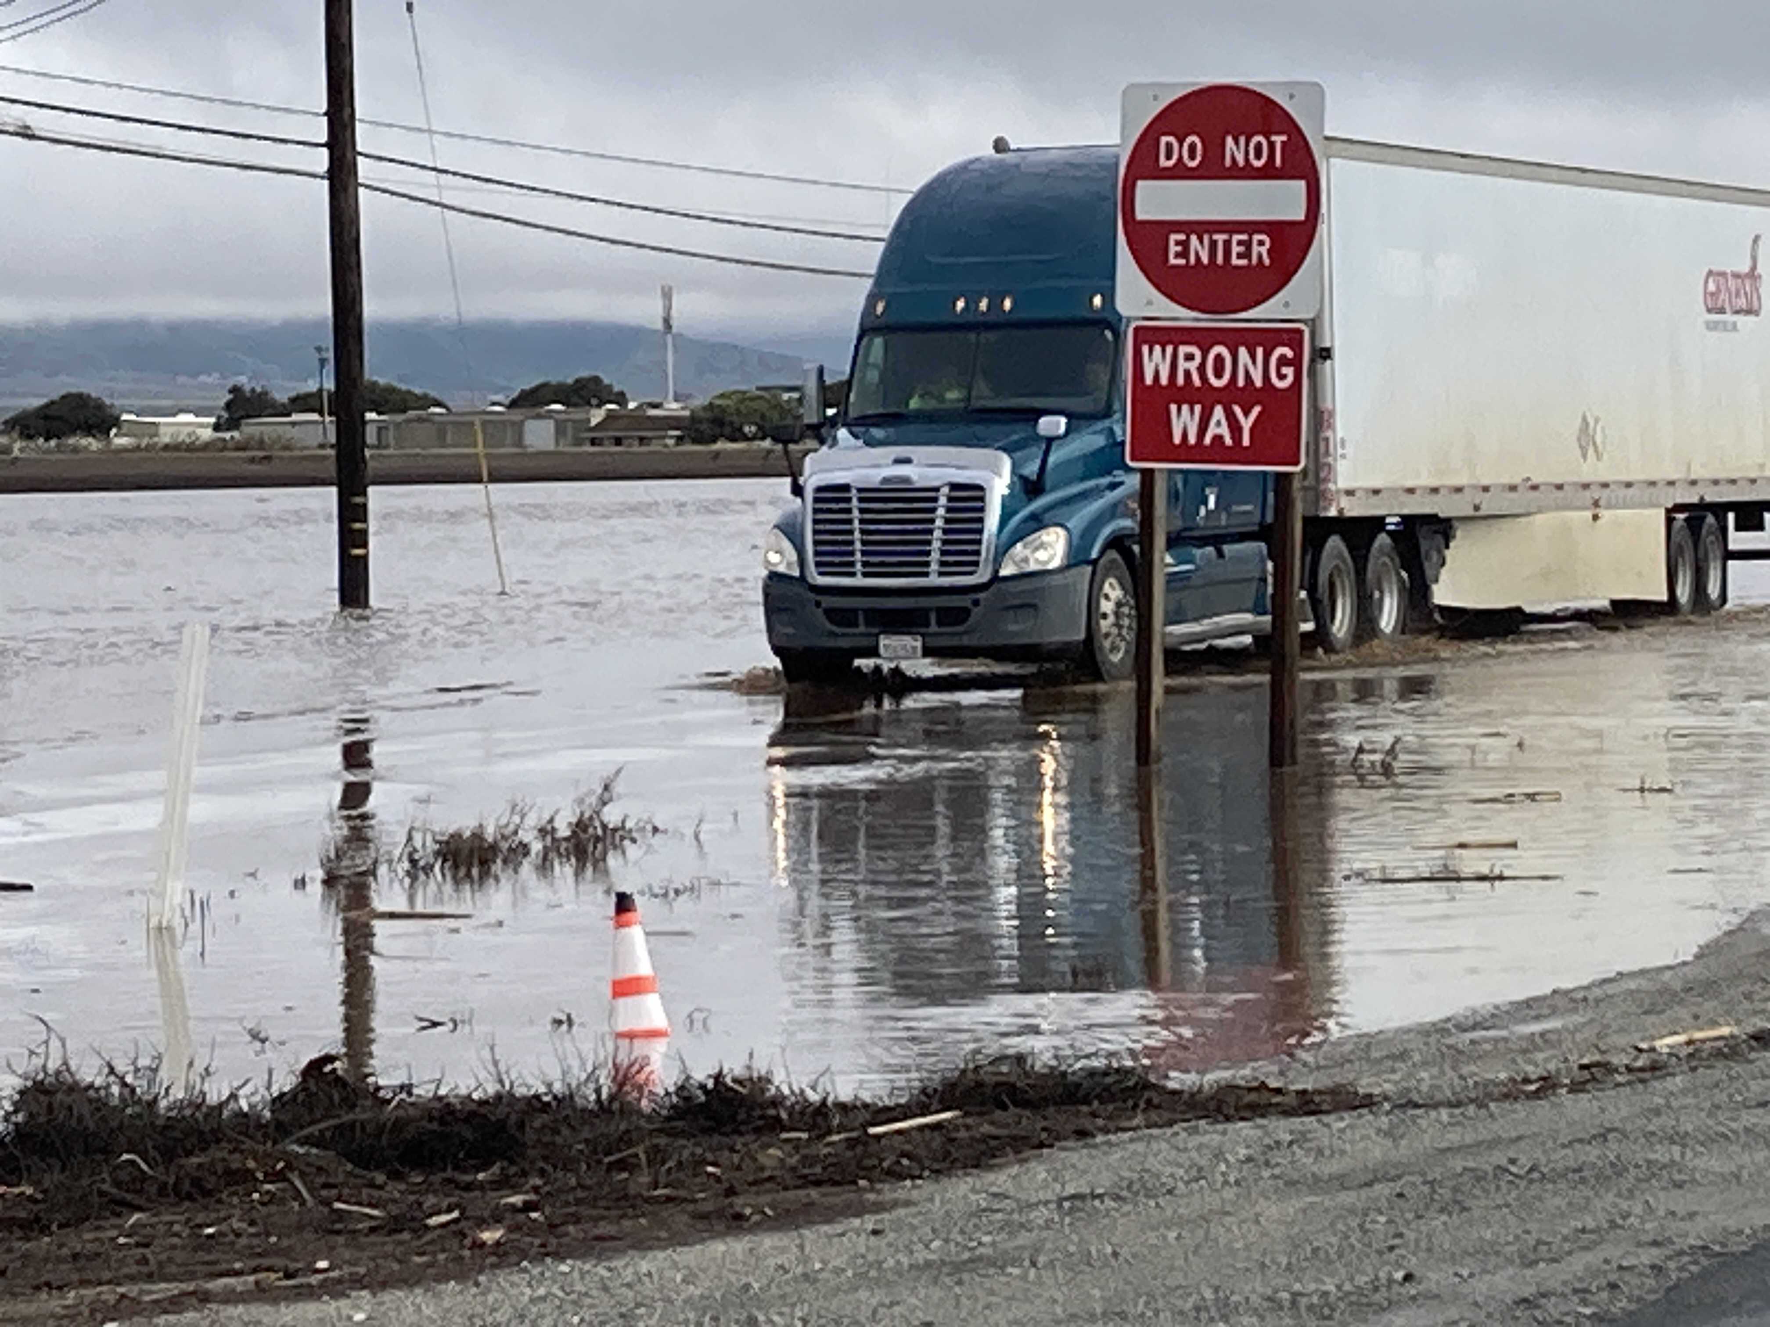
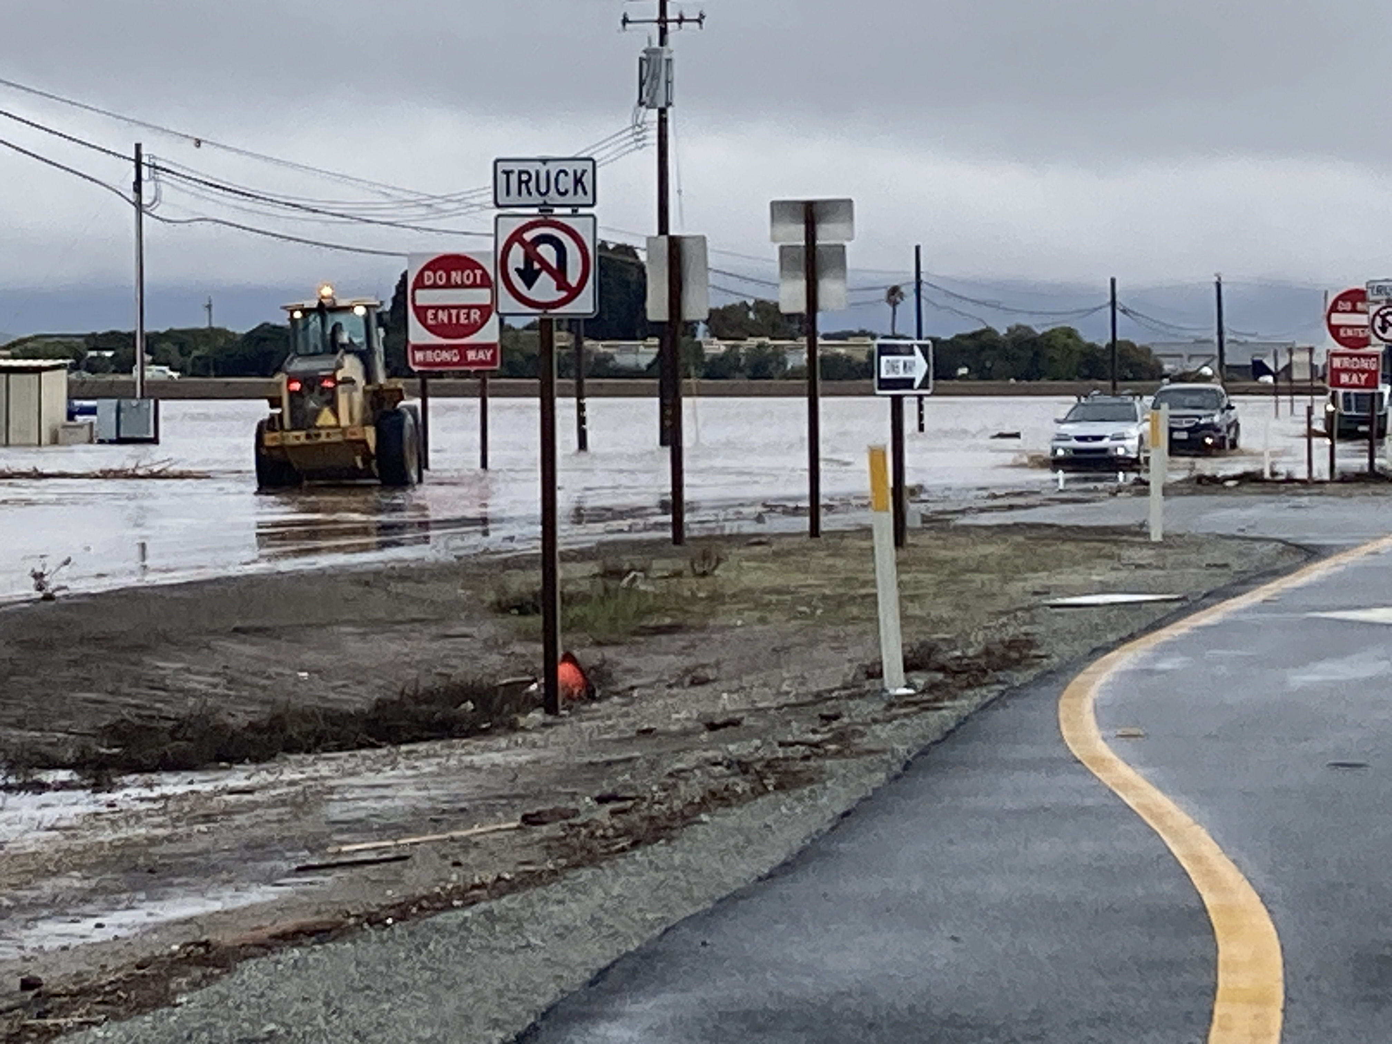
FLOODING
County and Caltrans are coordinating on potential Solutions.
Some Solutions will probably be included in project.

Slide 14
STATUS: Preliminary Design and Environmental Phase
Surveys
Traffic Analysis
Developing Preliminary Concepts
Community Engagement Plan
Preparing for Public Meeting (Fall 2023)

Slide 15
Stages to Delivering Projects
Right of Way and Permits
Assess
Needs & Constraints
Identify Viable Concepts
Construction
Env. Review
Alternative Selected
Design
Today
Public Input and Feedback
Secure Funding

Slide 16
SCHEDULE
Draft Environmental Document Winter 2025
Project Approval & Final Environmental Document Summer 2026
Preliminary Concepts Summer 2023
Public Meeting Fall 2023

Slide 17
QUESTIONS

Slide 18
ALTERNATIVES
NO LONGER UNDER CONSIDERATION
  Full Corridor Widening
    Construct 4-Lane Expressway
    Greater Environmental Impacts
    High Cost & Challenging to Fund
    Does not Align with Current Federal and State Funding Policies

Slide 19
ALTERNATIVES
NO LONGER UNDER CONSIDERATION (continued)
  Full and Corral de Tierra Bypass
    New 2 – 4 Lane Roadway Alignment between Corral de Tierra Road & State Route 218
    Concept developed as part of Fort Ord Reuse Plan
    Larger Footprint with Greater Environmental Impacts (Fort Ord National Monument protected under federal law, Section 4(f) of DOT ACT (49 United States Code 303)
    High Cost & Challenging to Fund
    Does not Align with Current Federal and State Funding Policies

Slide 20
ALTERNATIVES
NO LONGER UNDER CONSIDERATION (continued)
  Managed Lanes
    Construct an Additional Center Lane to be used for Westbound Traffic in the AM and Eastbound Traffic in the PM Peak Periods
    Difficult to Implement Due to the Number of Intersections
    On-going Operations and Maintenance Challenges

