Slide 1
2023 Competitive Grants Program
Transportation Agency for Monterey County
Board of Directors
March 22, 2023

Slide 2
Agenda
Program Overview
Fund Estimate
Program Changes
Timeline
Next Steps
Competitive Grants Program
March 21, 2023
Pacific Grove Point Pinos Trail Project

Slide 3
Program Overview
Fund Source:
Regional Surface Transportation Program
Transportation Development Act 2%
Eligible Uses:
Highways, local streets, bicycle and pedestrian improvements, and limited transit
Fund Cycle:
FY 23/24 – 25/26
Competitive Grants Program
March 21, 2023

Slide 4
Fund Estimate
Regional Surface Transportation Program Fiscal Years 2023/24/25 | $18,000,000
Reserve (10%) | $1,800,000
Rail Project Set Aside | $2,600,000
Funds Available | $13,600,000
Fair Share | $3,600,000
Quick-Build Project Pilot Program | $1,000,000
Balance of Funds for Competitive | $9,000,000
Transportation Development Act 2% | $750,000
Estimated Competitive Grant Funding | $10,750,000
Competitive Grants Program
March 21, 2023

Slide 5
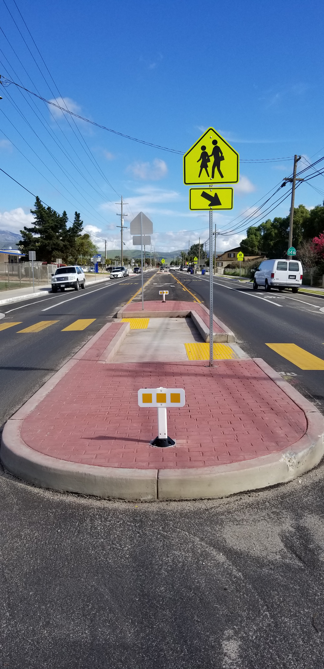
Program Changes
Quick-Build Project Pilot Program
Before-and-After Study Requirement
Bicycle Level of Traffic Stress Analysis
Benefit/Cost Ratio Analysis
Disadvantaged Communities
Metz Road, Soledad
5
Competitive Grants Program
March 21, 2023

Slide 6
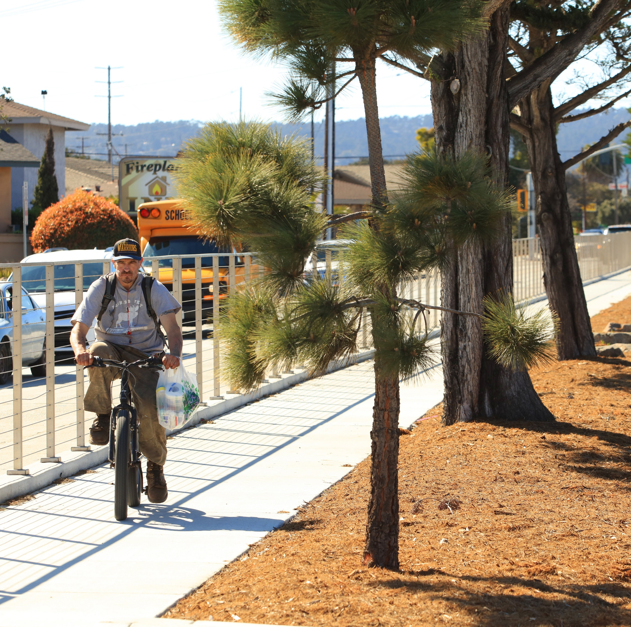
Eligible Projects
Roundabouts or traffic circles
Protected intersections
Signal modifications/upgrades
Bicycle and pedestrian trails
Electric vehicle stations
Bike racks or bike lockers
Road repaving and rehabilitation
Vision Zero safety projects
Fremont Street, Monterey
6
Competitive Grants Program
March 21, 2023

Slide 7
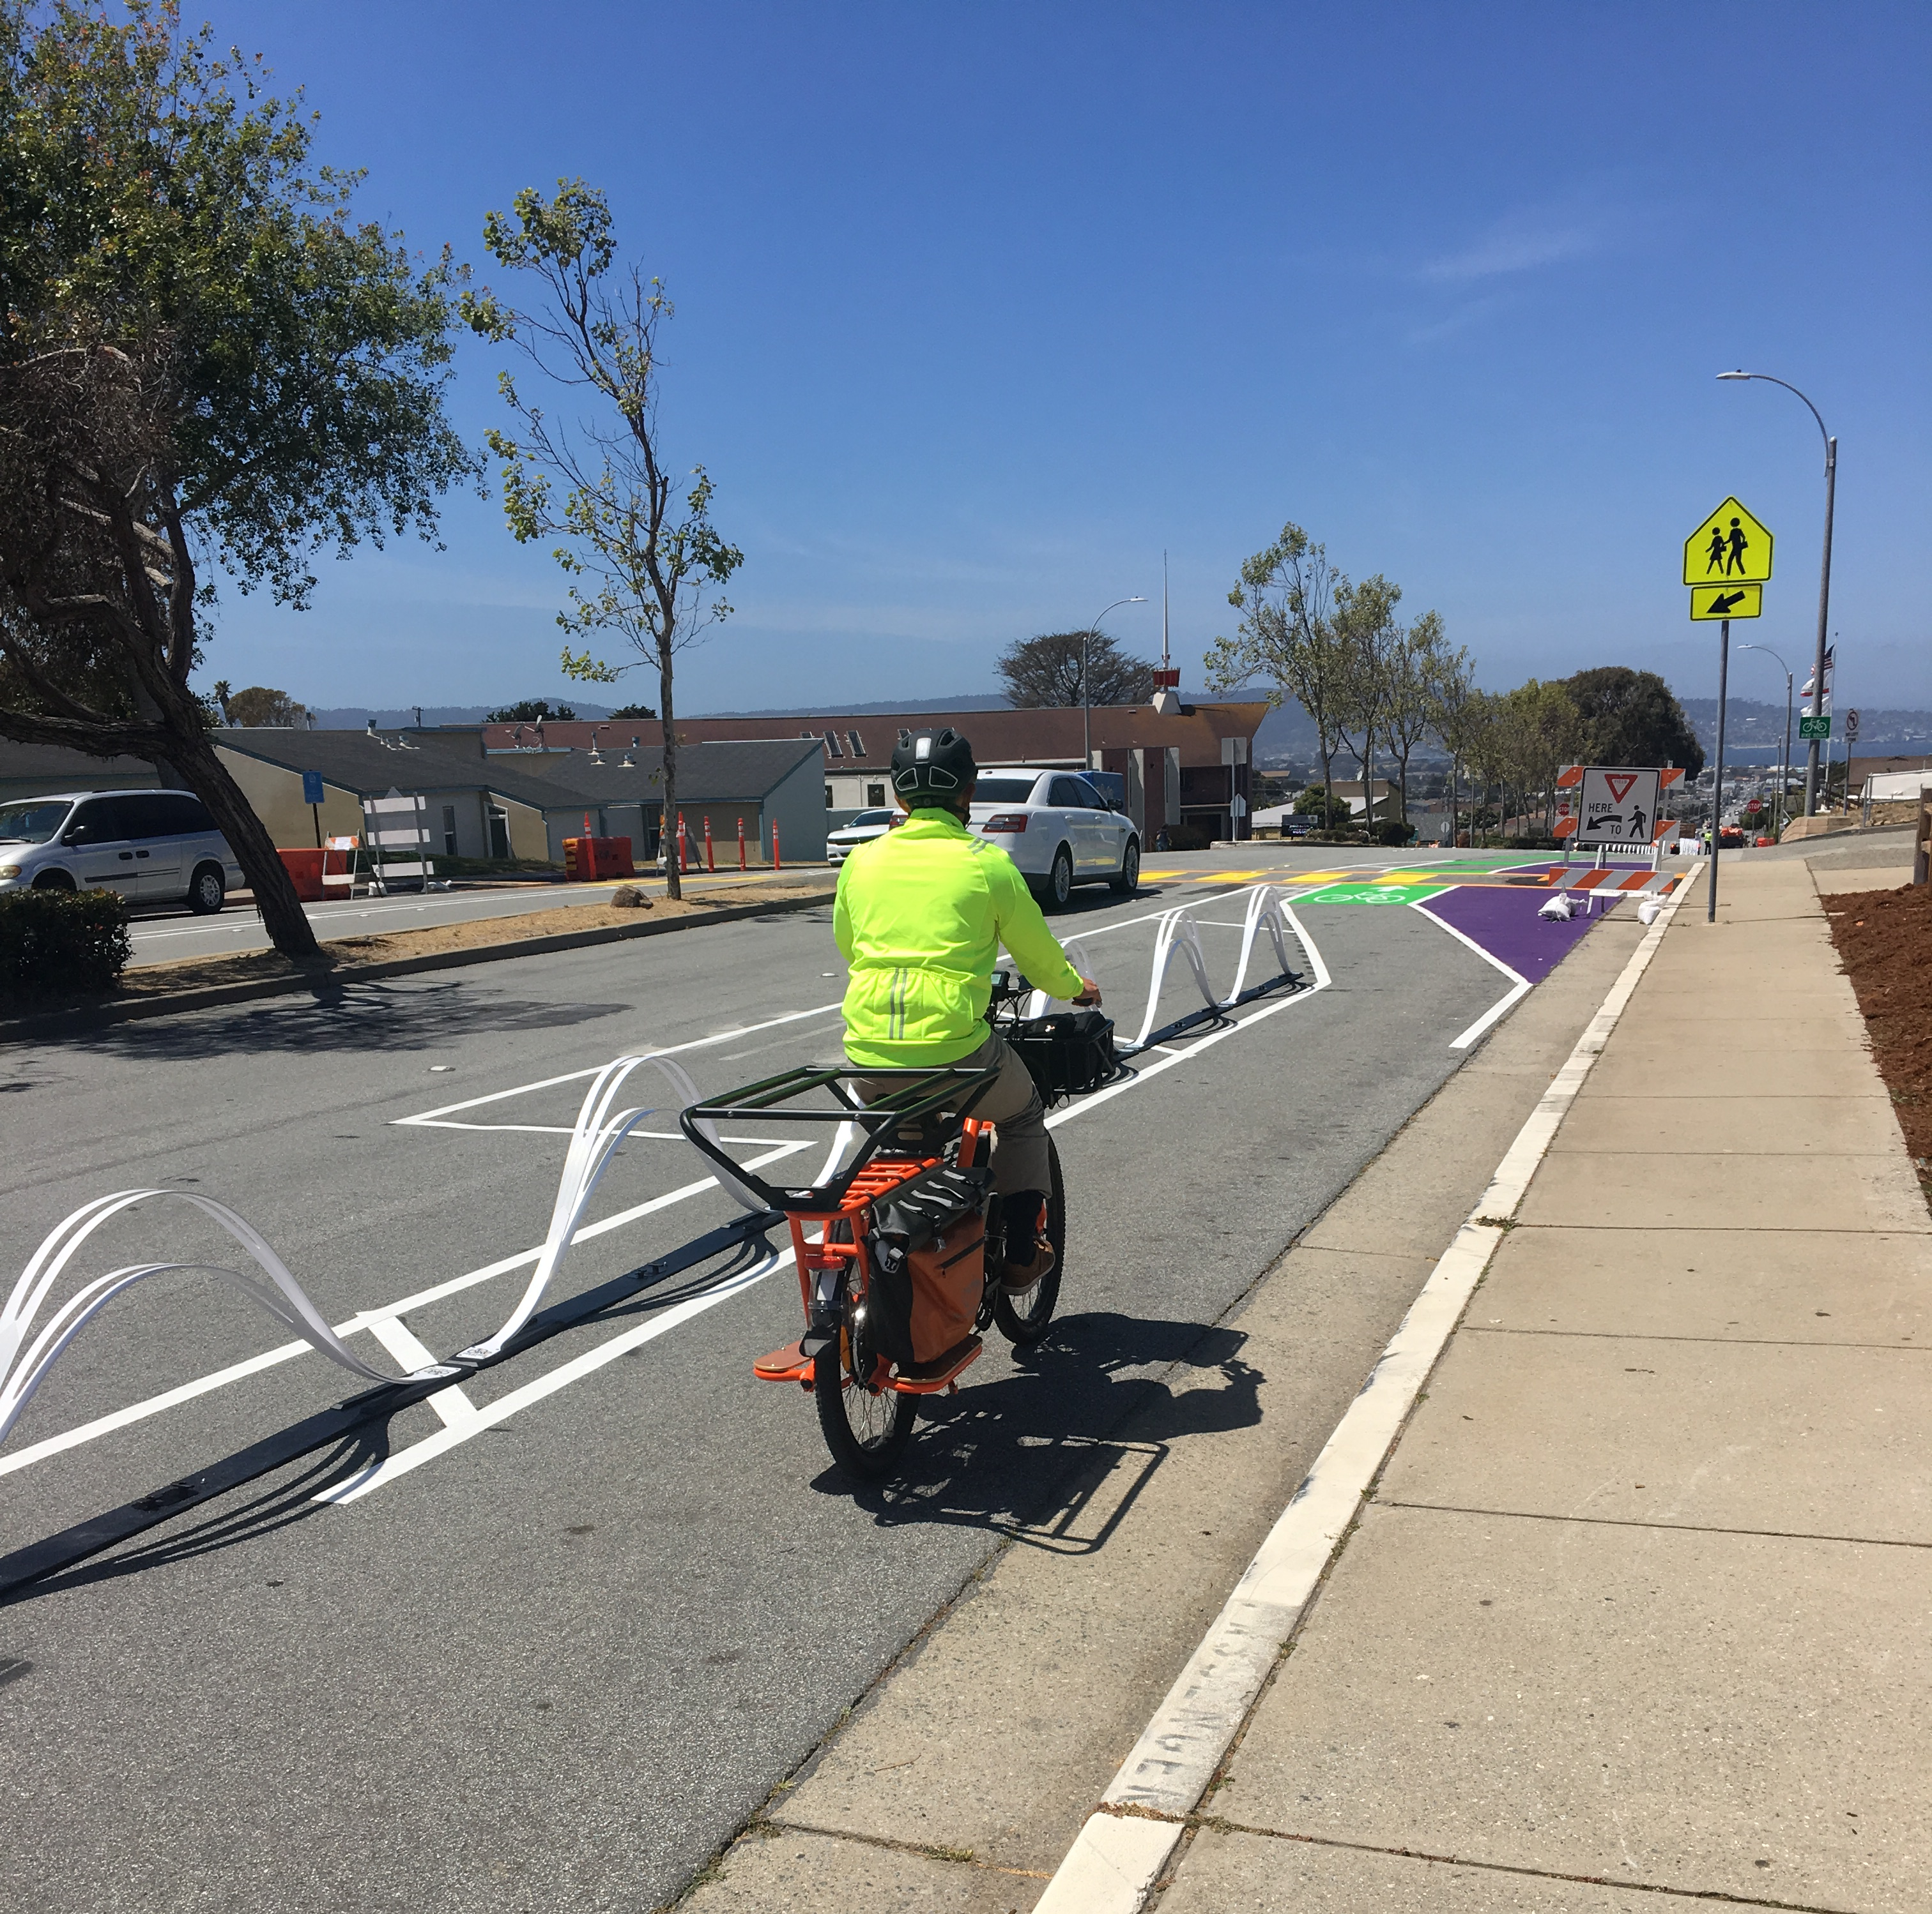
Program Changes
Quick-Build Project Pilot Program
Competitive application
Quickly address safety needs and improve comfort
Durable, low to moderate cost materials lasting 1 to 5 years
Implementation within 2 years
Pop-up at MLK Elementary School, Seaside
7
Competitive Grants Program
March 21, 2023

Slide 8
Program Changes
Before-and-After Study Requirement
Support future development of innovative treatments
All projects
Aligned with stated project benefits
Before study prior to construction
After study completed 12 months after construction
Metz Road, Soledad
8
Competitive Grants Program
March 21, 2023

Slide 9
Program Changes
Bicycle Level of Traffic Stress Analysis
Competitive application
Analysis tool provided is based on the Mineta Transportation Institute report “Low-Stress Bicycling and Network Connectivity” and NACTO’s “Urban Bikeway Design Guide”
Points given to projects that anticipate improved level of traffic stress
Fremont Street, Monterey
9
Competitive Grants Program
March 21, 2023

Slide 10
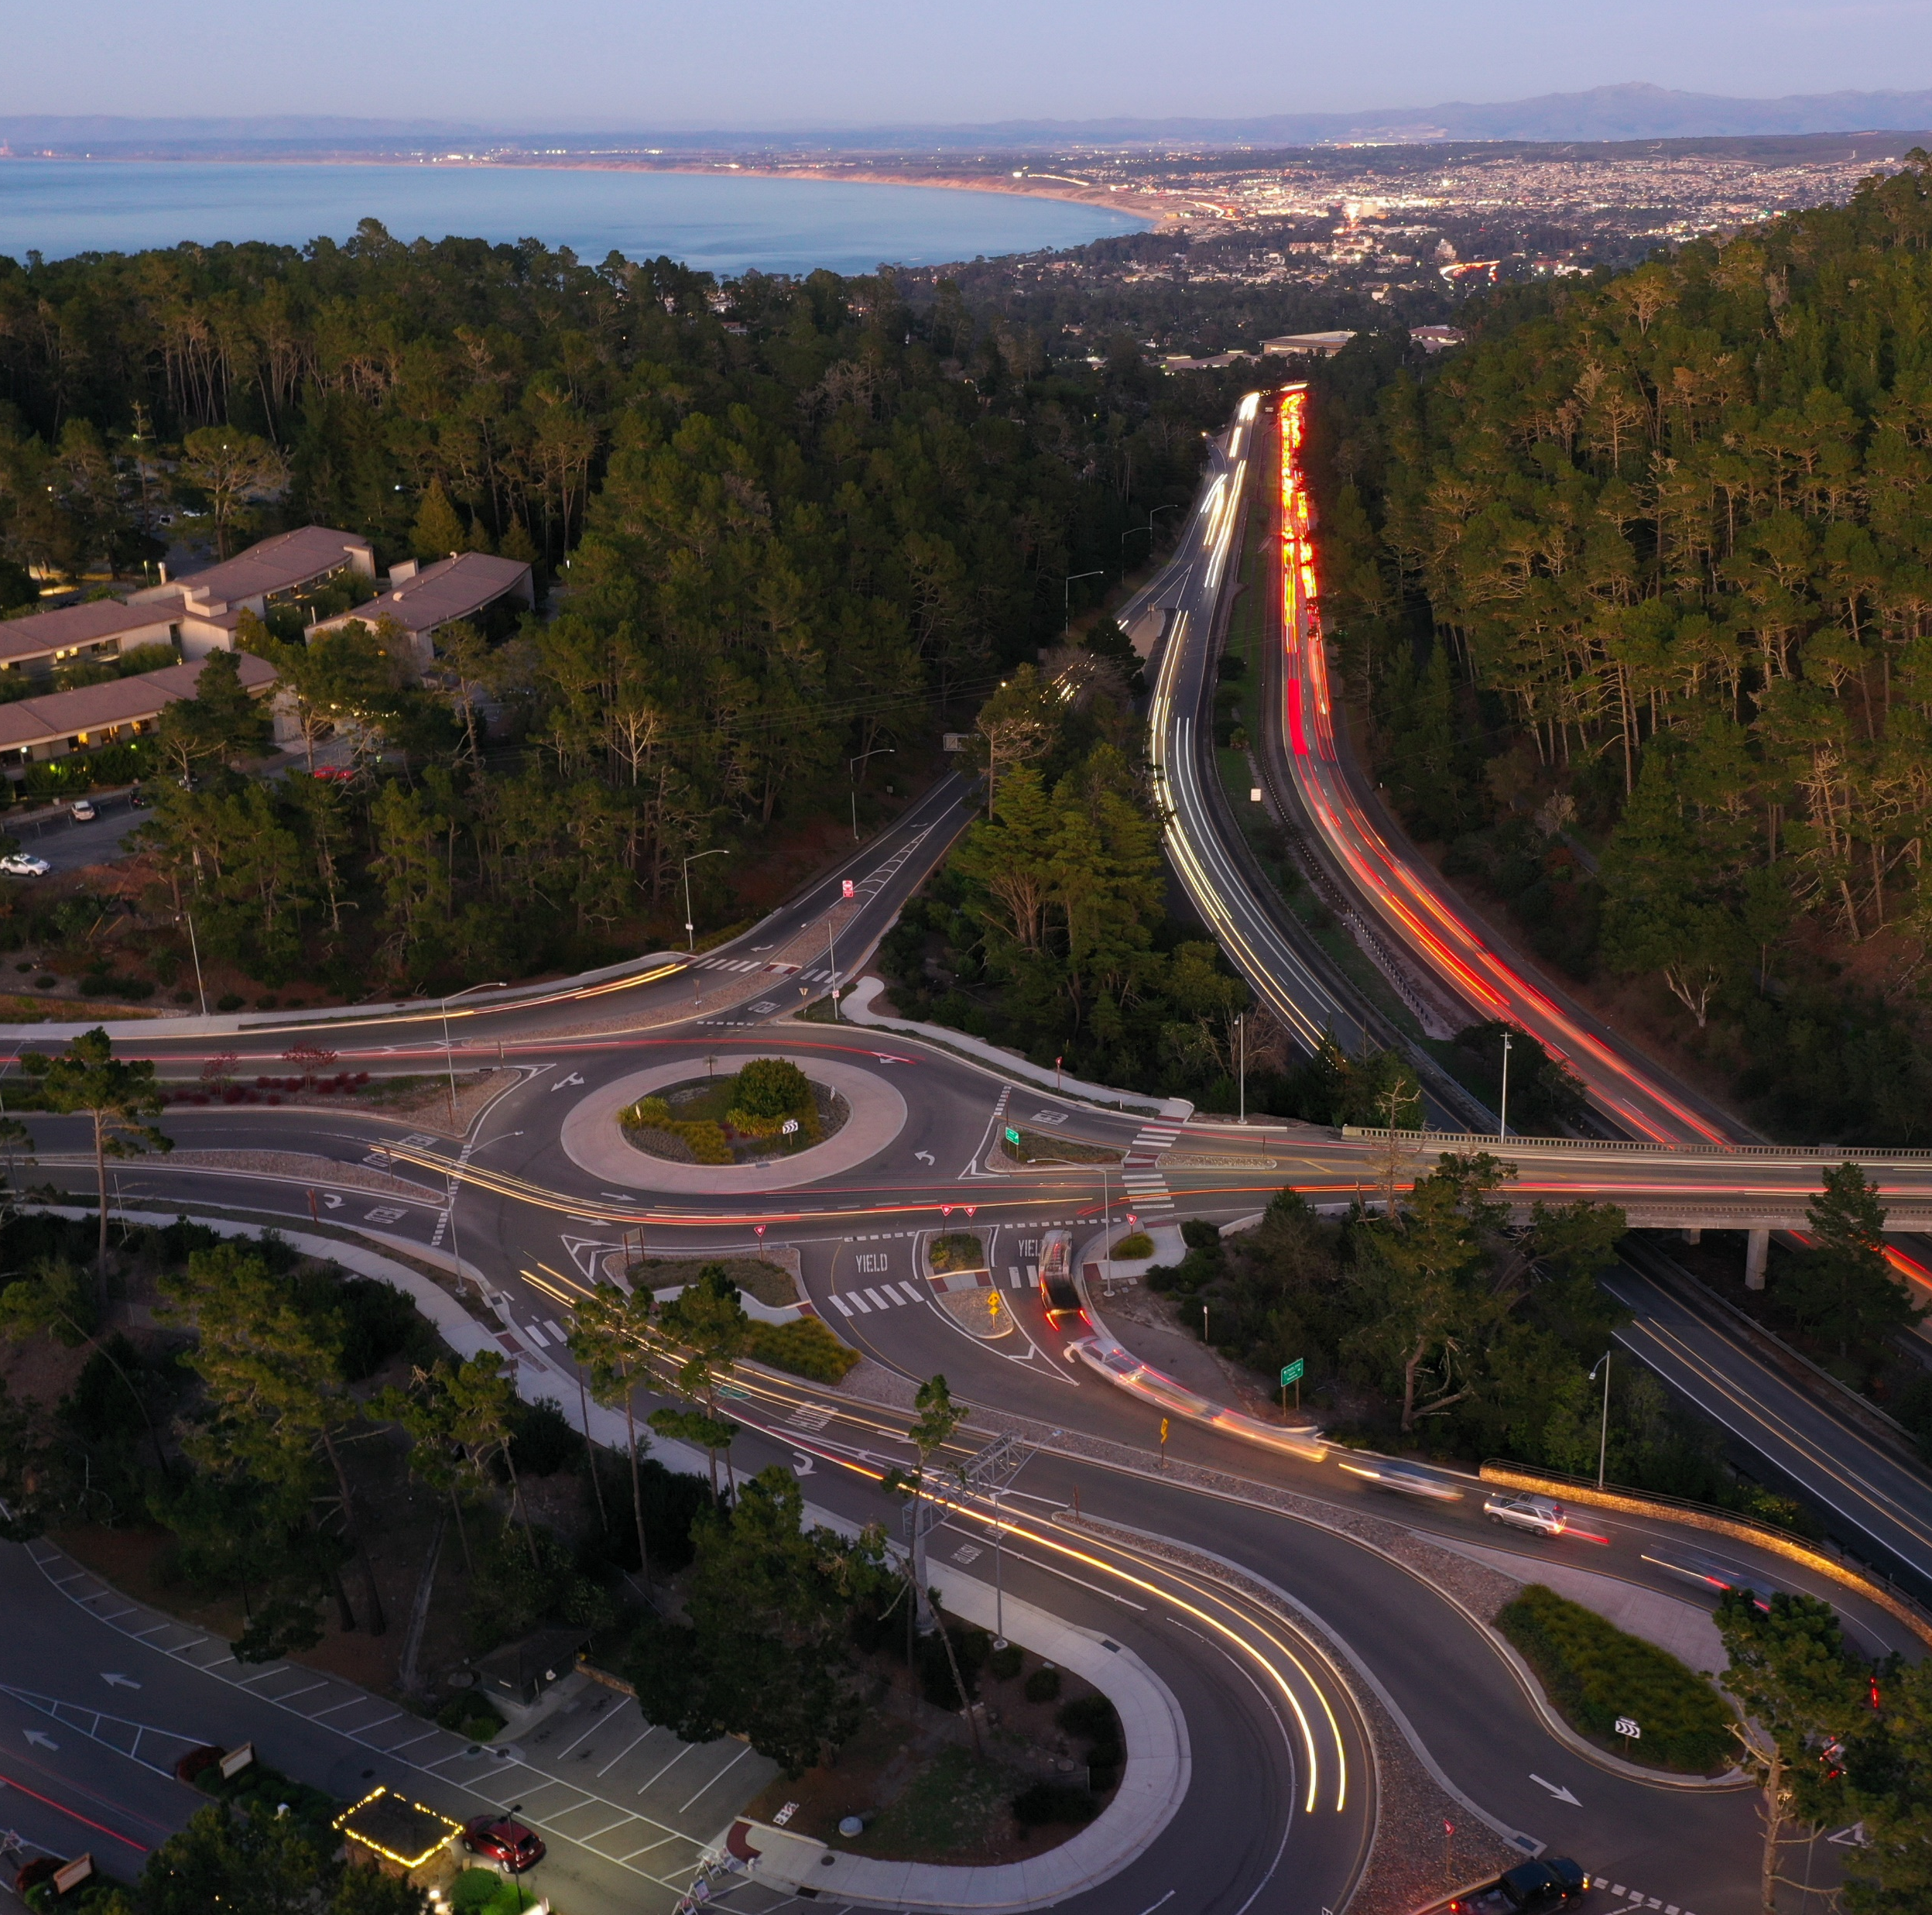
Program Changes
Benefit/Cost Ratio Analysis
Competitive application
Moved from screening criteria to scoring criteria
Disadvantaged Communities
Benefits to disadvantaged communities
Addresses the needs of people with disabilities
Holman Highway, Monterey
10
Competitive Grants Program
March 21, 2023

Slide 11
Timeline
Tasks | Deadline
TAMC Board Action: Approve Guidelines & Policies Call for Projects | March 22, 2023
Establish Review Committee | May 3, 2023 (BPC nominations) May 4, 2023 (TAC nominations)
Grant Applications Due | June 1, 2023
Committee Application Review Finalized | June 22, 2023
Review Committee Scores | August 2, 2023 (BPC) August 3, 2023 (TAC)
TAMC Board Action: Approve Project Nominations via resolution | August 23, 2023
Competitive Grants Program
March 21, 2023

Slide 12
Next Steps
Approve today’s staff recommendation
Enter into new 3-year funding agreements
Release the call for projects
Solicit participants in for the review committee
Applications due June 1, 2023
Board approval of projects at the August 23, 2023 meeting
Holman Highway, Monterey
12
Competitive Grants Program
March 21, 2023

Slide 13
Staff Recommendation
APPROVE programming $3,600,000 of fair share formula Regional Surface Transportation Program (RSTP) Funds to the cities and County;
APPROVE setting aside $1,800,000 (10%) of RSTP funds to the TAMC RSTP reserve;
APPROVE setting aside $2,600,000 of RSTP funds to the Monterey County Rail Extension project;
APPROVE the 2023 Master Funding Agreement template allowing minor modifications as approved by agency council; and
APPROVE updated guidelines and application and RELEASE a call for projects to program $10,750,000 of competitive Transportation Development Act 2% and RSTP funds.
Competitive Grants Program
March 21, 2023

Slide 14
Thank you
Comments or questions?
Janneke Strause
Janneke@tamcmonterey.org
(831) 775-4410
Downtown Salinas Complete Streets Project

