Slide 1

Measure X Citizen Oversight Committee
April 15, 2025
Agenda Item No. 4
Monterey County
Measure X
Local Projects Update

Slide 2
PRESENTATION OVERVIEW
Brief background
Completed and Current Projects
Planned Projects
Questions or Comments

Slide 3
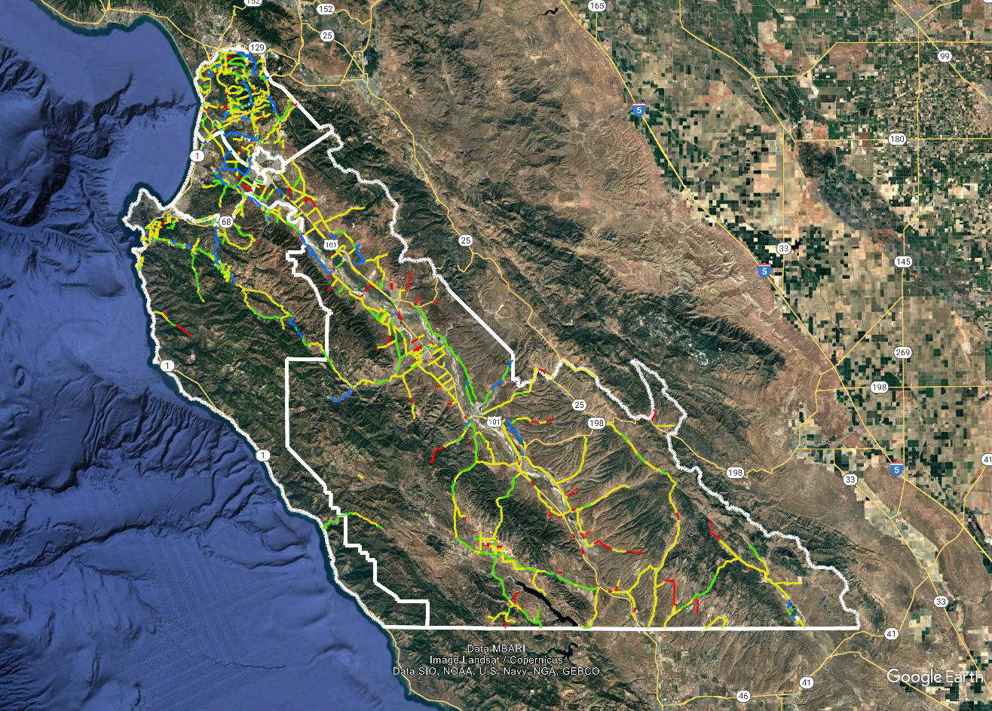
Background - County Road Network
PCI
0-25
26-50
51-70
71-100

Slide 4
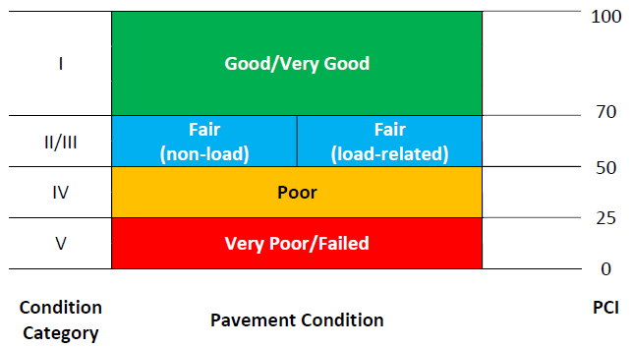
Pavement Condition Index (PCI)
Asphalt Concrete Distresses
Alligator or Fatigue Cracking
Block Cracking
Distortions
Longitudinal/Transverse Cracking
Patching and Utility Cuts
Rutting and Depressions
Raveling
Weathering
Portland Cement Concrete Distresses
Corner Break
Divided Slab
Faulting
Longitudinal/Transverse Cracking
Patching and Utility Cuts
Scaling/Map Cracking/Crazing
Spalling

Slide 5
County Transportation Infrastructure
1,263 +/- miles of County maintained roads
175 County maintained bridges
Deferred Maintenance (est. $1.5 billion)
  Roads
  Bridges
  Road appurtenances (signage, signals, etc.)
Some progress made with Measure X and SB 1
Additional BOS support via Measure AA
Notes:
The county as other road system related assets including bridges and appurtenance (e.g. signs) where there are significant deferred maintenance needs. That said, the focus of the 2020 Board referral was to establish a funding program that would improve the condition of the County’s road s to at least a Fir standard over the next 10 years.

Slide 6
Road Fund Uses By Source
HUTA
MOE
(TOT)
Measure X
SB 1 / RMRA
Use for PW Maintenance, admin, other non-project staff costs
CIP Projects
Annual Seal Program
Local Road Rehabilitation Program

Slide 7
CIP Projects- Measure X/SB 1 Funding
Bridge Replacements
Traffic Safety Projects
Bike/pedestrian projects
Emergencies

Slide 8
Completed and Current Projects

Slide 9
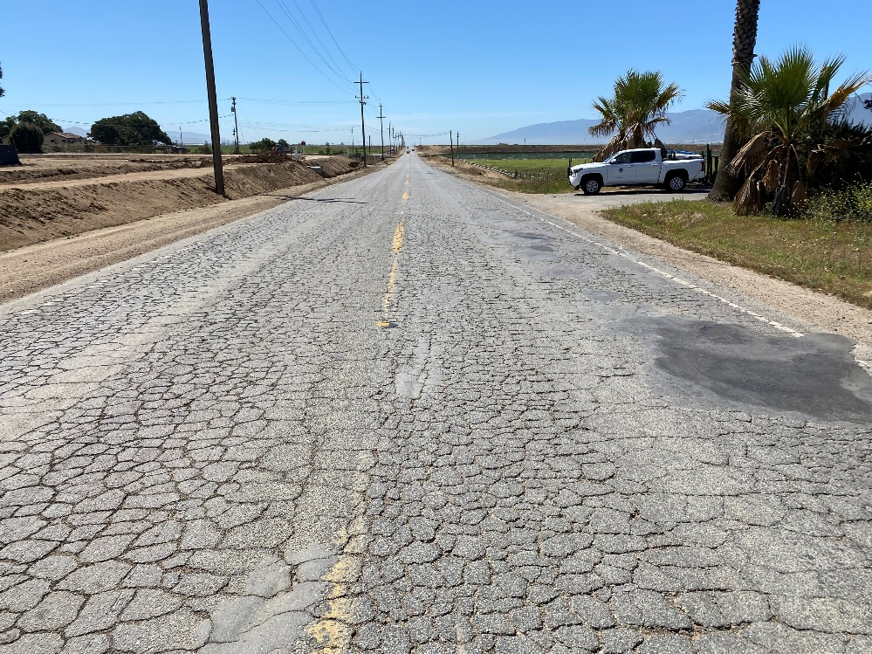
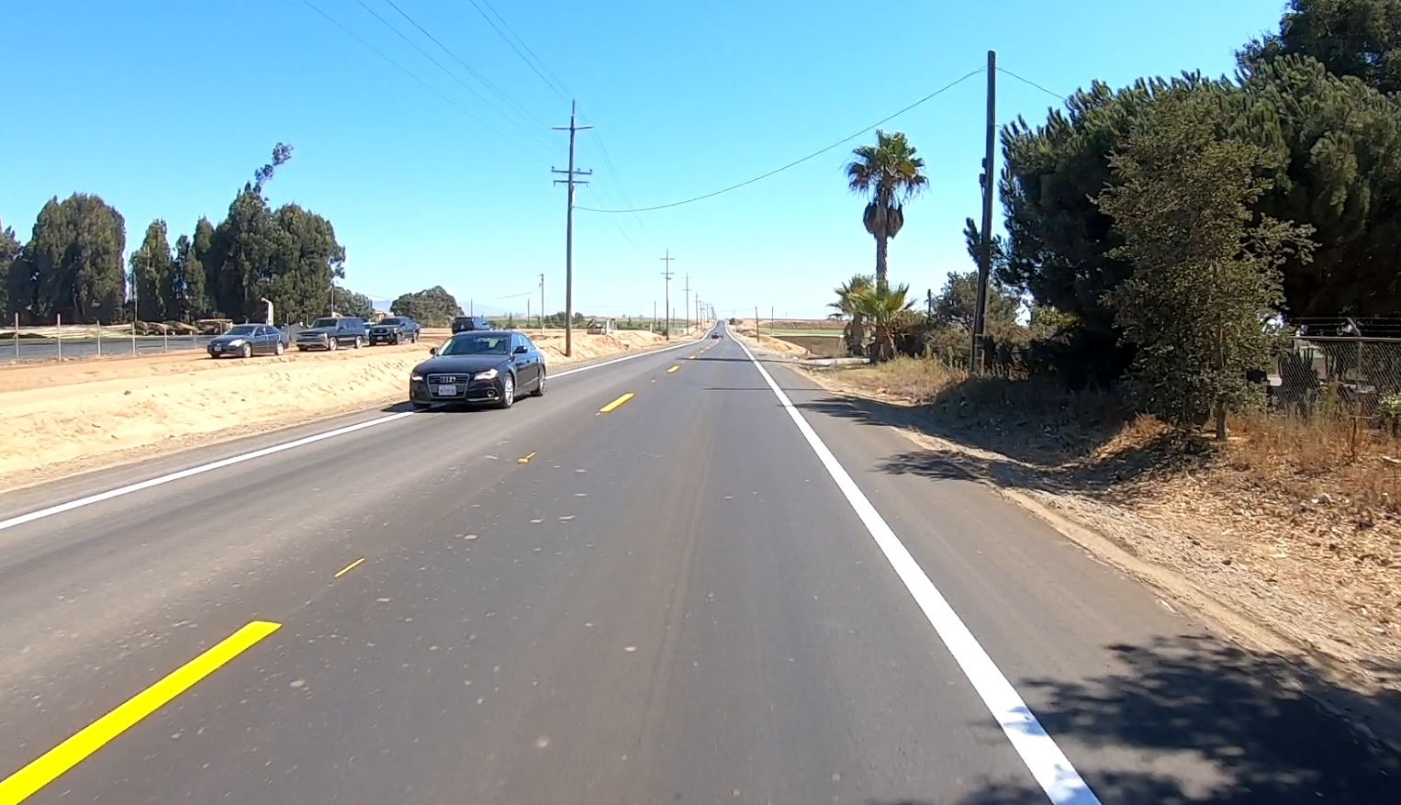
Alisal Road Pavement Reconstruction
Reconstructed the pavement from City limits to Hartnell Road
Replaced drainage culverts and reconstructed drainage ditches
Completed December 2024
Total project cost: $4.88 million
Before
After
Notes:
Jolon Road Bridge Rail Replacement $129,255
The Jolon Road Bridge Rail Replacement Project consists, in general, of replacing the existing bridge rails, to meet current State standards. The total project cost, including environmental, engineering, and construction, is $989,250. The project is funded by the FHWA Highway Bridge Program (HBP) with Measure X providing the require local match. Construction was completed in December 2020.

Slide 10
Hitchcock Road and Foster Road Pavement Reconstruction
Pavement reconstruction and drainage culvert replacement
Completion Date: January 2025
Total project cost: $4.90 million
Repaved Hitchcock Road
Notes:
River Road Rehabilitation (Portola Drive to Las Palmas Parkway) $2,163,738
The project rehabilitated River Road from Portala Drive to Las Palmas Parkway, near the City of Salinas. The existing pavement was recycled in place and was used as base for the new roadway, utilizing a “Green” technology known as Full-depth Reclamation. The roadway was then paved with hot-mix-asphalt. Project also included vegetation clearing and rehabilitating the existing drainage. River Road is part of the Wine Corridor that stretches from Salinas down to Greenfield. River Road is part of the list of roads to be completed under the Measure X program. Construction was completed in December 2020.

Slide 11
Hitchcock Road Pavement Reconstruction
Before
After

Slide 12
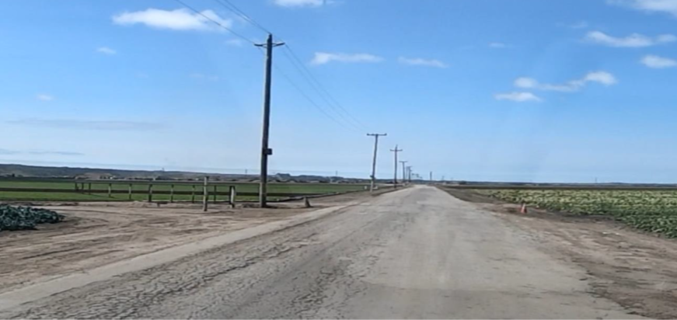
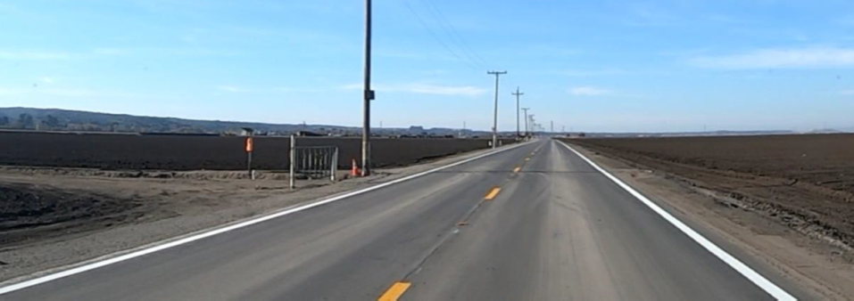
Foster Road Pavement Reconstruction
Before
After

Slide 13
FY 2024 Pavement Seal Project
Pavement rehabilitation and resurfacing
  Reservation Road (East Garrison Rd-Panziera Rd / Davis Rd-Portola Dr)
  Blanco Road (Alisal Rd – Davis Rd)
  River Road (MP 6.47 to MP 7.77 )
Completion Date: August 2024
Total project cost: $4.30 million
Notes:
River Road Rehabilitation (Portola Drive to Las Palmas Parkway) $2,163,738
The project rehabilitated River Road from Portala Drive to Las Palmas Parkway, near the City of Salinas. The existing pavement was recycled in place and was used as base for the new roadway, utilizing a “Green” technology known as Full-depth Reclamation. The roadway was then paved with hot-mix-asphalt. Project also included vegetation clearing and rehabilitating the existing drainage. River Road is part of the Wine Corridor that stretches from Salinas down to Greenfield. River Road is part of the list of roads to be completed under the Measure X program. Construction was completed in December 2020.

Slide 14

River Road Pavement Rehabilitation
After

Slide 15
Reservation Road Pavement Rehabilitation
After

Slide 16
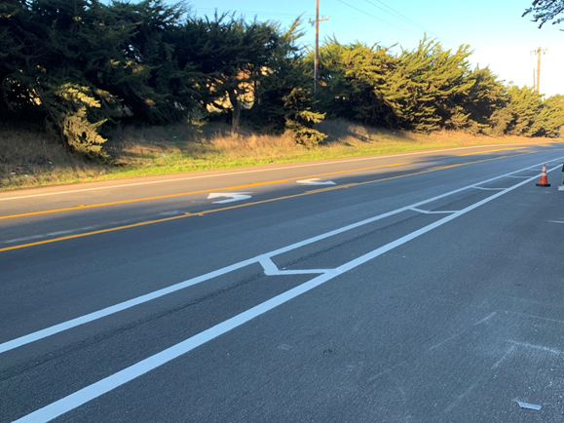
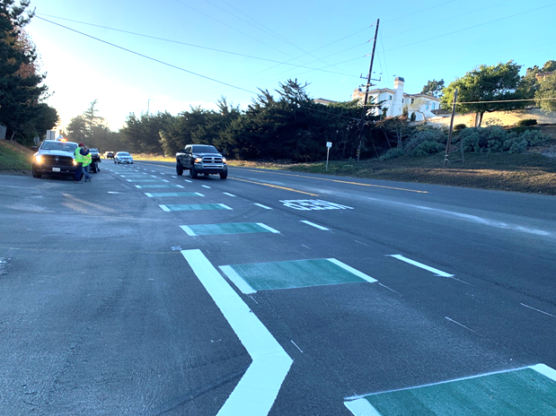
Elkhorn Rd./Werner Rd./Salinas Rd.
Intersection Safety Improvement
Interim safety improvements per G12 Corridor Study
Completed Elkhorn Road merge lane in September 2023
Salinas Road Two-Way Left Turn Lane
Salinas Road Bicycle Lanes
Notes:
The project is to provide interim safety improvements to the Elkhorn Road / Werner Road / Salinas Road Intersection to improve the driving experience for motorists. This project also included improvements at the Salinas Road / Fruitland Avenue intersection. This project is a partial component of the improvements identified in the G-12 Pajaro to Prunedale Corridor Study. The project consists of a ‘road diet’ that includes the installation of Two Way Left Turn Lane pavement markings (TWLTL) on Salinas Road, installation of a westbound refuge/acceleration lane within the striped median at the intersection of Werner Road and Salinas Road, and a slurry seal of the pavement. Cost of improvements was $264,412 and was funded with Measure X funds. Improvements were completed in December 2020.

Slide 17
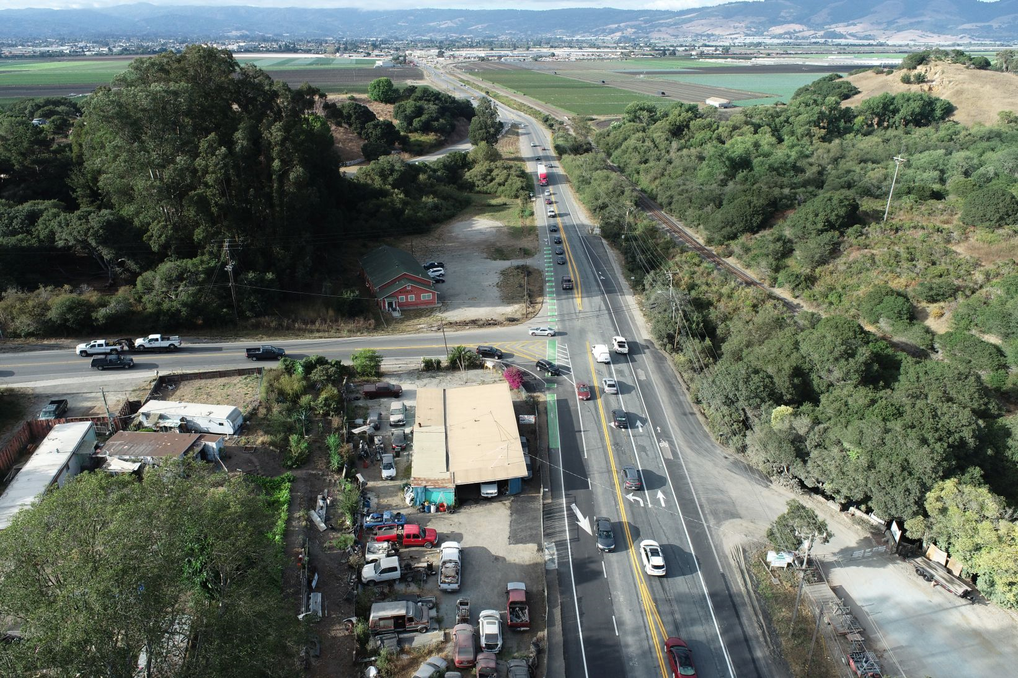
Elkhorn Rd./Werner Rd./Salinas Rd.
Intersection Safety Improvement

Slide 18
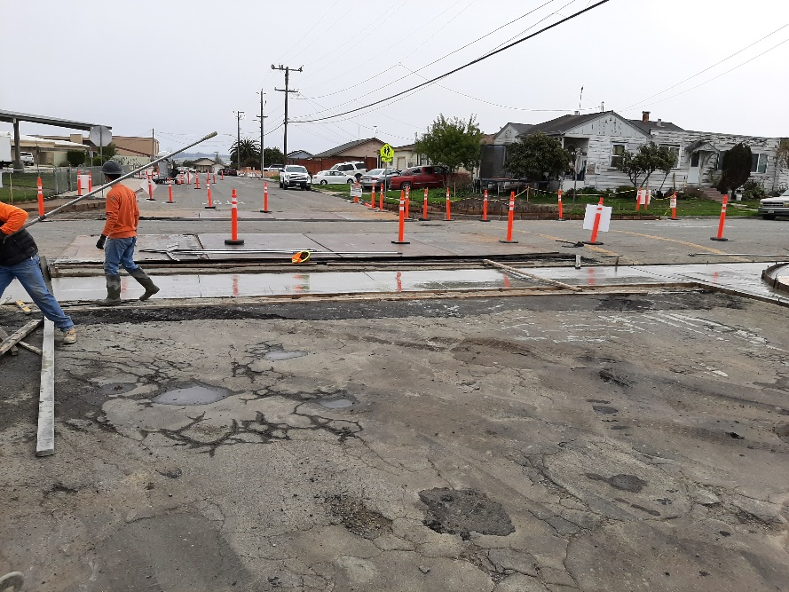
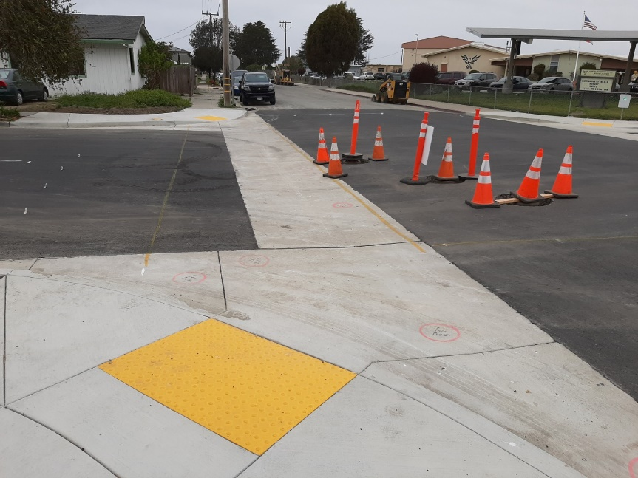
Measure X Community Street Improvements
Castroville and Boronda
Street and ADA ramp improvements
Completed May 2021 through December 2024 (thus far)
Total project cost: $1.4 million each year
After
Early Construction
Near Completion
Notes:
The project resurfaced Cooper Street from State Route 183 to Blevins Way, in the Community of Castroville. Project also included reconstructing sidewalk ADA curb ramps. The project cost was approximately $1 million, funded by Measure X. The project contractor was Teichert Construction, performed through JOC. Construction was completed in May 2021.

Slide 19
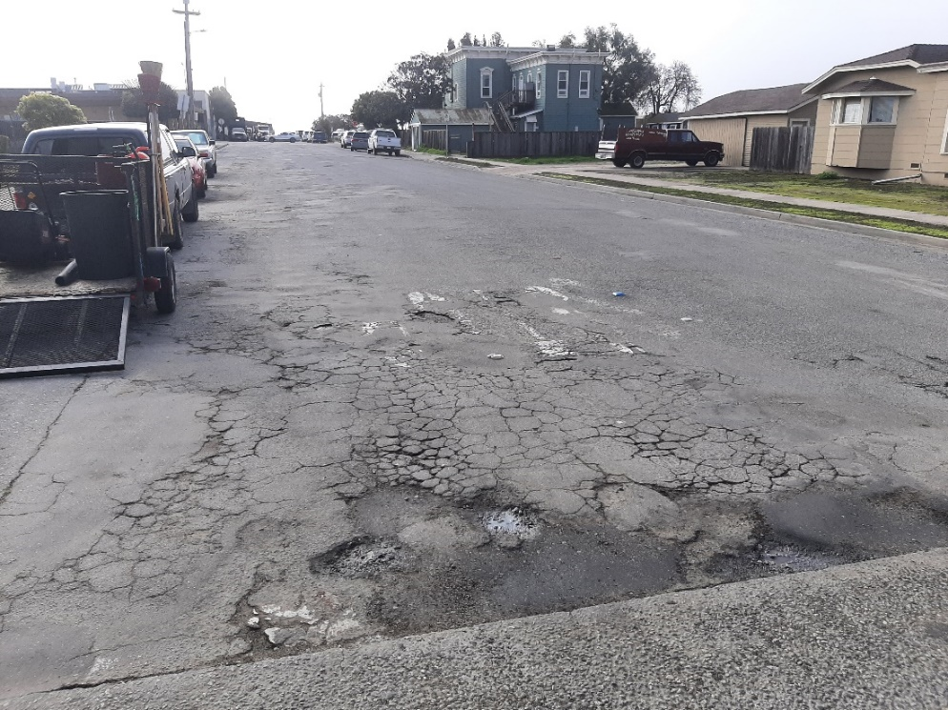
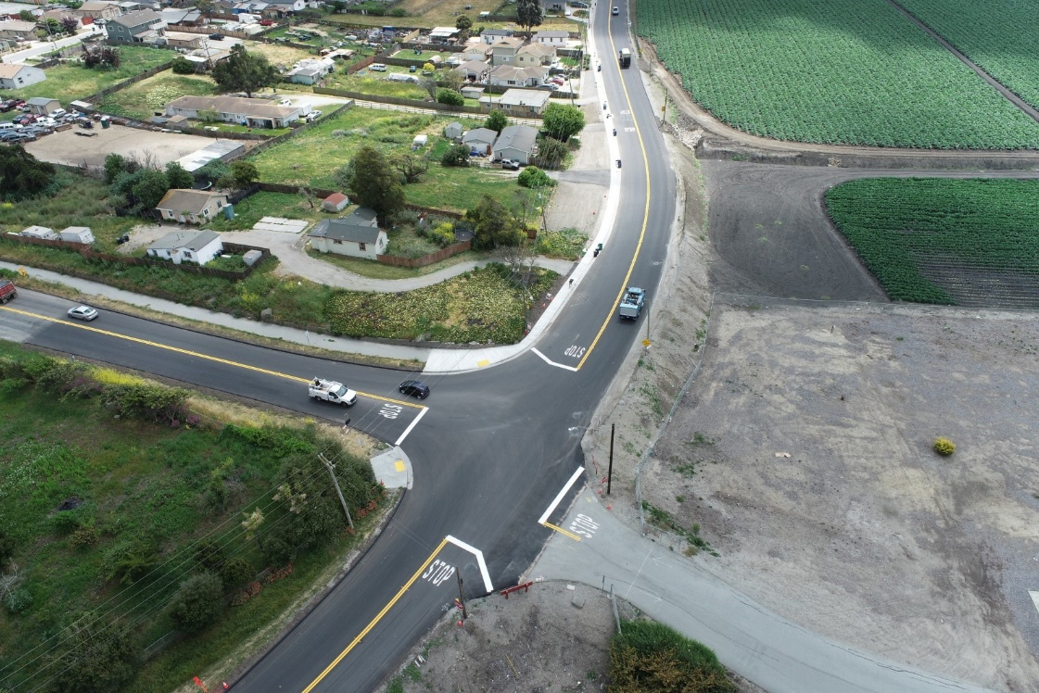
Measure X funded
Community Street Improvements
Before
After

Slide 20
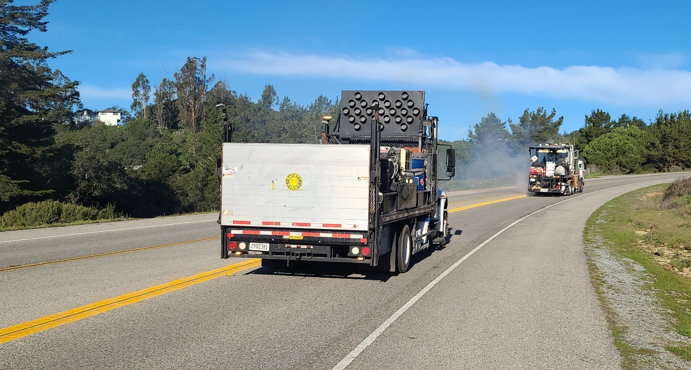
Annual Countywide Striping Program
Re-stripe road centerline stripe
Total annual estimated project cost: $600k
Target completion time: Spring and Fall
Striping Application on Echo Valley Road
Notes:
The project is based on a Roadway Safety Signage and Striping Audit (RSSA) that was funded by a Highway Safety Improvement Program (HSIP) grant. The County was awarded a Highway Safety
Improvement Program (HSIP) grant in amount of $3,222,200 by the California Department of Transportation (Caltrans). The study evaluated approximately 250 miles of County roads throughout the
County, and made various recommendations. These recommendations are being implemented in the construction phase. The construction phase of this project, in general, consists of striping 39 miles of
county roads at various locations throughout the county (with no passing zone detail 22 where warranted) and replacing existing signs, relocating existing signs, and installing new signs as identified in
the project plans to meet current State standards (the California Manual of Uniform Traffic Control Devices, or CA-MUTCD). The project is mostly funded with HSIP funds and the Measure X funds will
provide the required local match.

Slide 21
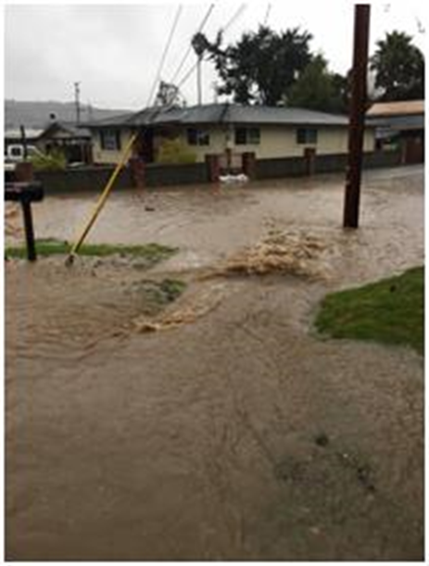
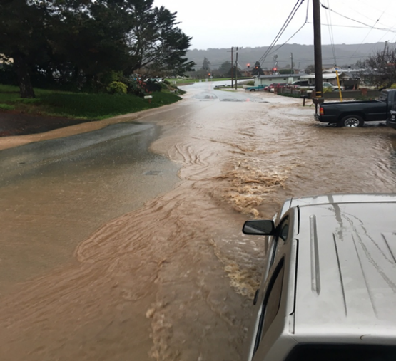
Las Lomas Drive Drainage and Street Improvements
Sill Road to Thomas Road
New storm drain system, road reconstruction and new sidewalks
Total estimated project cost: $9.6 million
Target completion:
  Completed storm drain
  Fall 2025 for street & sidewalk
Typical Flooding
Notes:
The Las Lomas Community has dealt with periodic localized flooding along Las Lomas Drive for years. The Project consists of the installation of new storm drainage infrastructure, pavement reconstruction, and utility relocations to allow space for the new storm drain system. Given the complexity of the Project, the project was divided in sections. The first section was completed in 2016 and consisted of replacing the large diameter culvert under Hall Road. The current phase is from Sill Road to Thomas Road. This phase is currently under construction and is anticipated to be complete in Summer 2022. The project is funded by County General funds and Measure X funds. The Measure X will be used to fully fund all the project sections.
Per Billy: $5.4 M for storm drain, to be completed by Aug/Sept 2022; $4.2 M for street\sidewalk to be constructed in Summe 2023

Slide 22
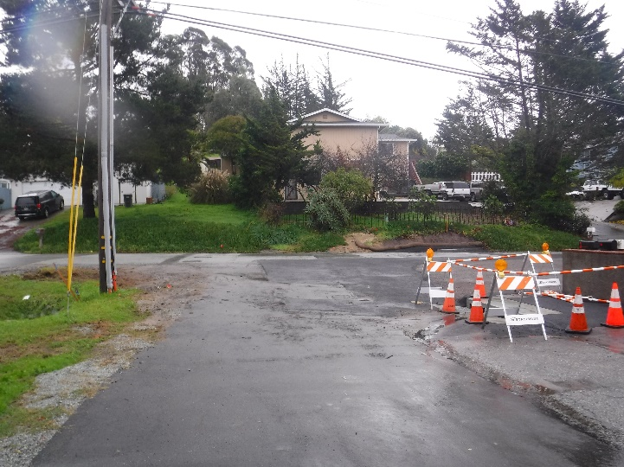
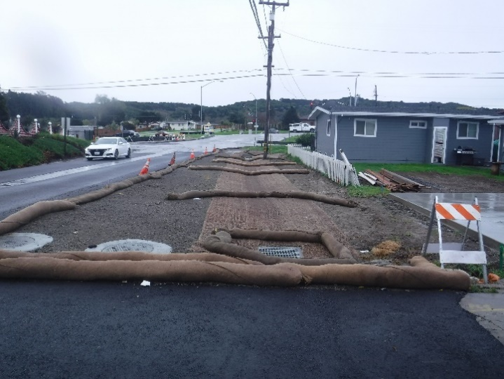
Las Lomas Drive Drainage
Sill Road to Thomas Road
Under Construction

Slide 23
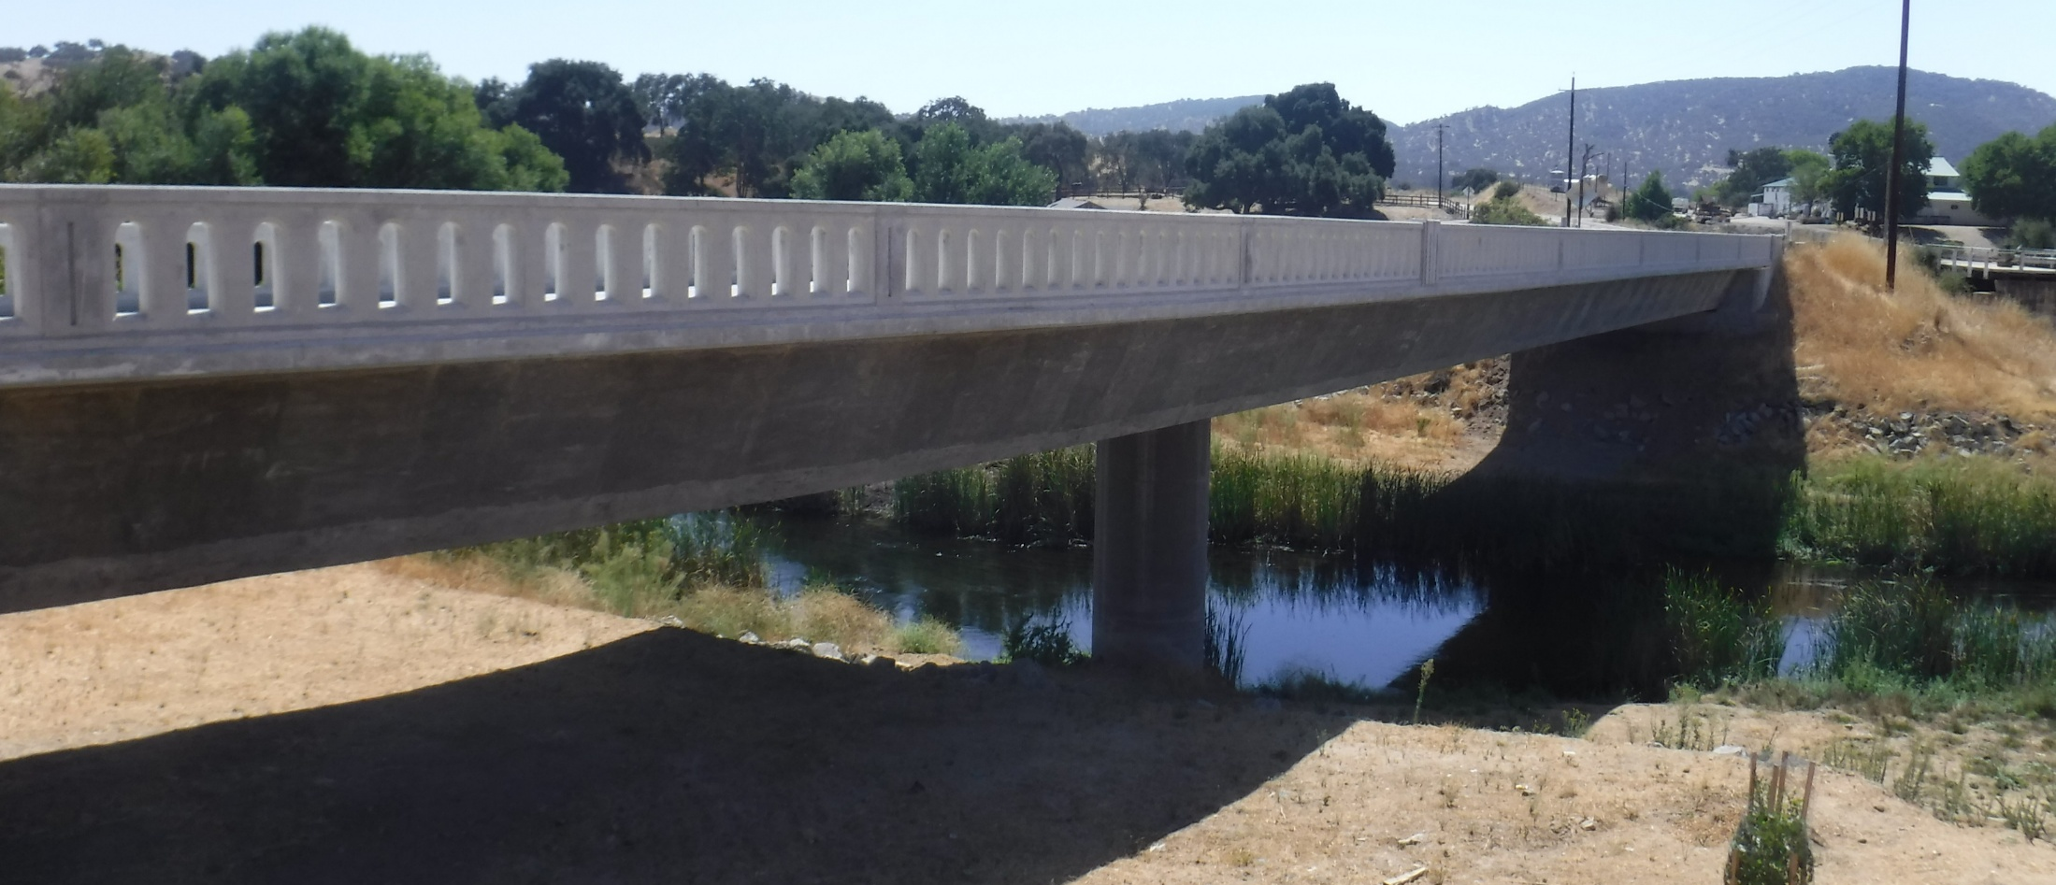
Nacimiento Lake Drive Bridge Replacement
Replace one-lane steel truss bridge with two-lane concrete bridge
FHWA HBP grant
Total estimated project cost: $11.3 million
Completed: Fall 2024
Notes:
The proposed project is located on Nacimiento Lake Drive approximately seven miles southwest of the community of Bradley in South County. The project is to replace the existing seismically deficient one-lane Nacimiento Lake Drive Bridge with a new two-lane bridge. The existing will be replaced with a structure that meets current California Department of Transportation (Caltrans) seismic standards. Project is currently in construction is anticipated to complete with functional use of the new bridge by end of Fall 2022. Demolition of old bridge to be complete by Spring 2023. The project is primarily funded by FHWA HBP with Measure X as a local match.

Slide 24
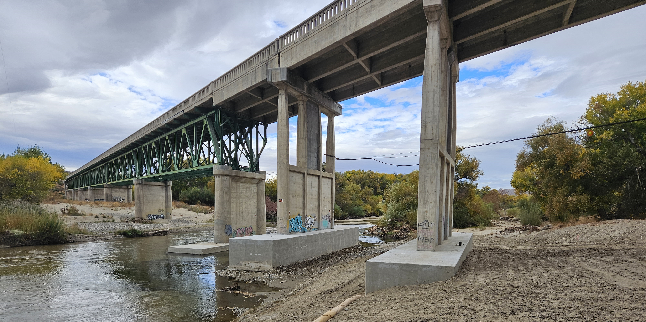
Bradley Road Bridge Scour Repair
Reconstruct bridge support piers
FHWA HBP grant
Total project cost: $11.85 million
Completed: Fall 2024
Retrofitted
Bridge Piers
Notes:
The project is to remediate the existing scour at the bridge piers of Bradley Road Bridge. The project is in currently in the Project Approval & Environmental Documentation (PA&ED) phase. The current project estimate, including engineering, environmental, and construction is $3.8 million. It is funded by FHWA HBP funds with Measure X as local match. Construction is tentatively scheduled for Summer 2022.

Slide 25
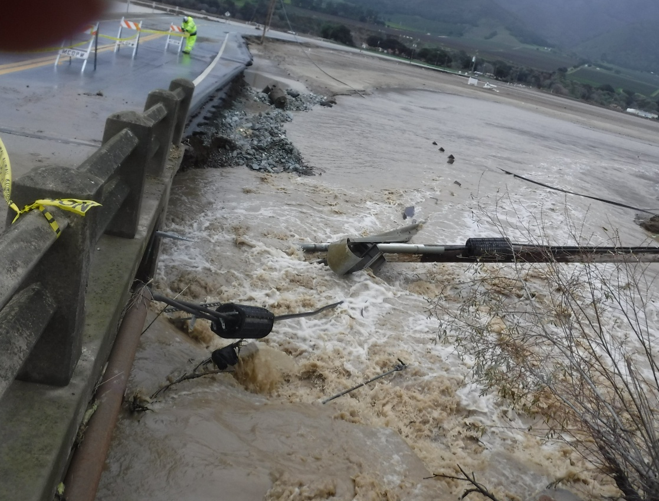
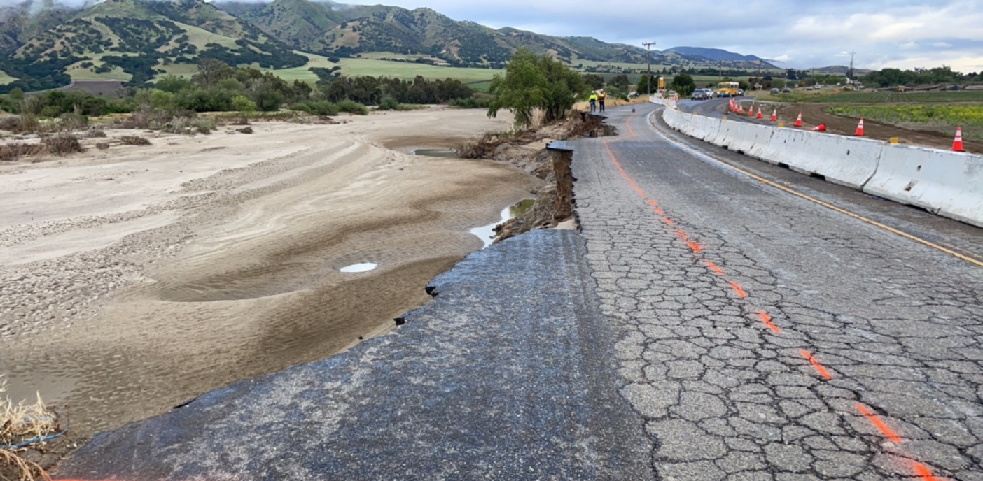
2023 Storm Repairs along key Ag routes
Gonzales River Road
Chualar River Road

Slide 26
FY 2025 Pavement Seal Project
Pavement rehabilitation and resurfacing
Carmel Valley Road
  Miramonte Rd to Valley Greens Dr (5 miles)
Completion Date: December 2024
Total project cost: $3.50 million
Notes:
River Road Rehabilitation (Portola Drive to Las Palmas Parkway) $2,163,738
The project rehabilitated River Road from Portala Drive to Las Palmas Parkway, near the City of Salinas. The existing pavement was recycled in place and was used as base for the new roadway, utilizing a “Green” technology known as Full-depth Reclamation. The roadway was then paved with hot-mix-asphalt. Project also included vegetation clearing and rehabilitating the existing drainage. River Road is part of the Wine Corridor that stretches from Salinas down to Greenfield. River Road is part of the list of roads to be completed under the Measure X program. Construction was completed in December 2020.

Slide 27
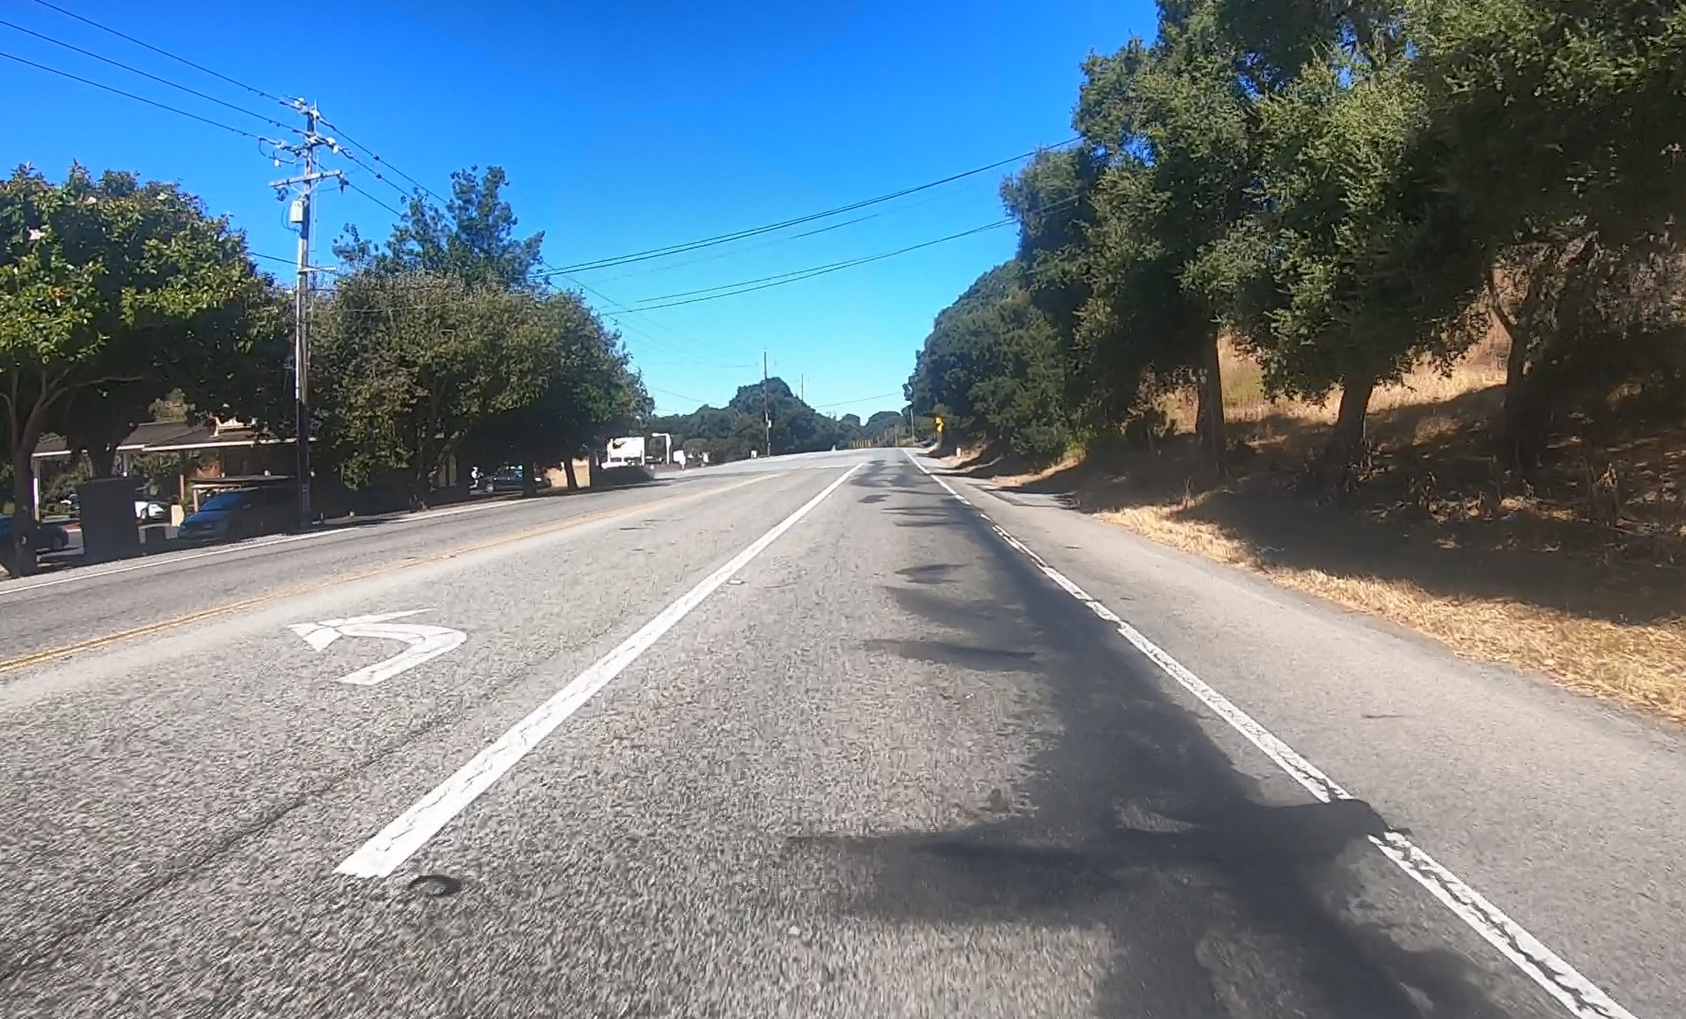
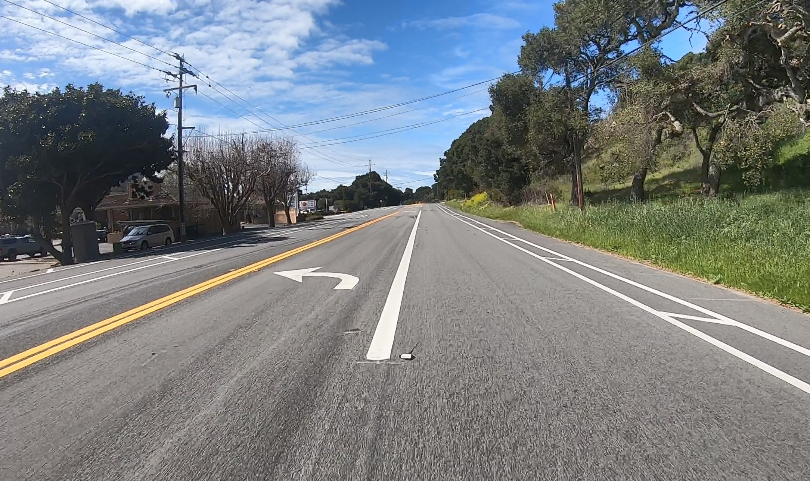
Carmel Valley Road Pavement Rehabilitation
After

Slide 28
Planned Projects

Slide 29
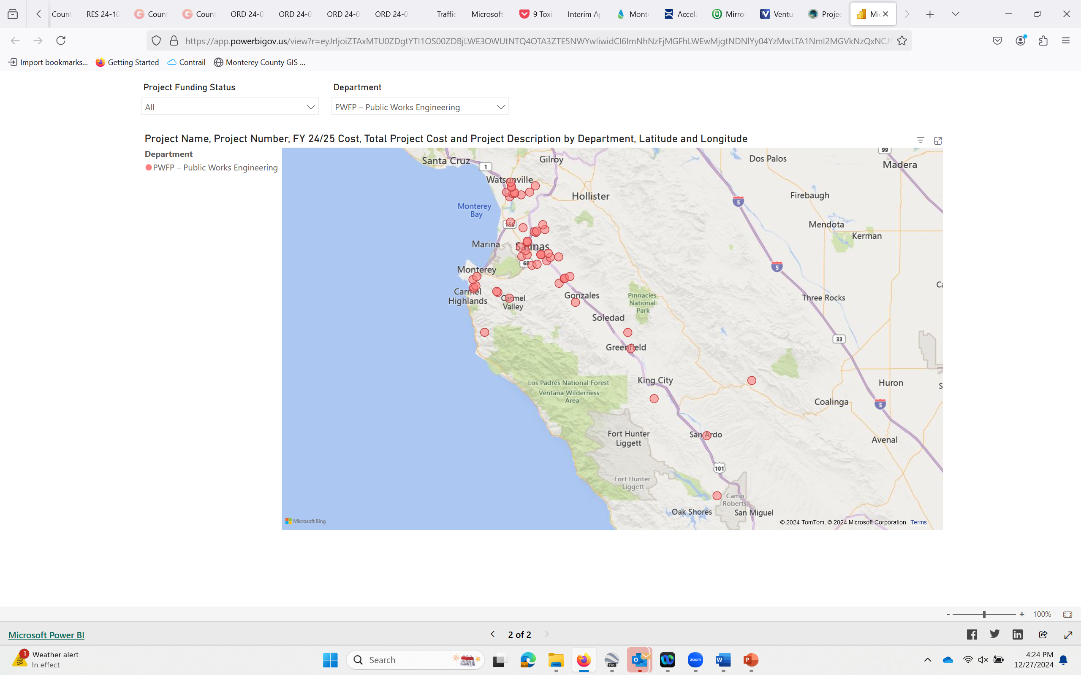
5-year Capital Improvement Program Plan

Slide 30
5-year Capital Improvement Program Plan
https://www.countyofmonterey.gov/government/departments-i-z/public-works-facilities-parks/public-works/divisions/project-development

Slide 32
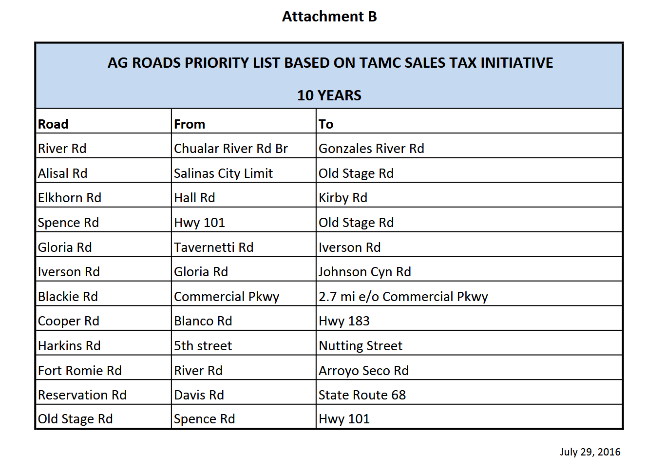
MEASURE X PROJECTS
Notes:
Old Stage Road: Iverson to Highway 101, Summer 2022; Design of remainder sections 2022-2023
Hartnell: new bridge $3M, completed Fall 2022
Robinson Canyon Bridge Scour repair: $3 M complete Fall 2022
Toro complete Fall 2022; Viejo Road complete Summer 2023
Castroville Summer 2022 road repair: Crane, Preston Speegle, McDougall, Pomber and Geil Streets (enompases library, NCFD station, NC Park District office, Our Lady of Refuge Church area
Monte bridge construct summer 2024

Slide 33
AG ROADS PRIORITY LIST
Road | From | To | Status
River Rd. | Chualar River Rd. Br | Gonzales River Rd. | Completed
Gloria Rd. | Tavernetti Rd. | Iverson Rd. | Completed
Iverson Rd. | Gloria Rd. | Johnson Canyon Rd. | Completed
Old Stage Rd. | Iverson Rd. | Highway 101 | Completed
Cooper Rd. | Blanco Rd. | Highway 183 | Completed
Harkins Rd. | 5th St. | Nutting St. | Completed
Old Stage Rd. | Iverson Rd. | Spence Rd. | In Phases
Alisal Rd. | Salinas City Limit | Old Stage Rd. | Completed
Reservation Rd. | Davis Rd. | State Route 68 | Completed
Fort Romie Rd. | River Rd. | Arroyo Seco Rd. | 5-Year Plan
Blackie Rd. | Commercial Pkwy | 2.7 mi. e/o Comm. Pkwy | 5-Year Plan
Spence Rd. | Highway 101 | Old Stage Rd. | 5-Year Plan
Elkhorn Rd. | Hall Rd. Salinas Rd | Kirby Rd. Strawberry | Design FY25, Construct FY26

Slide 34
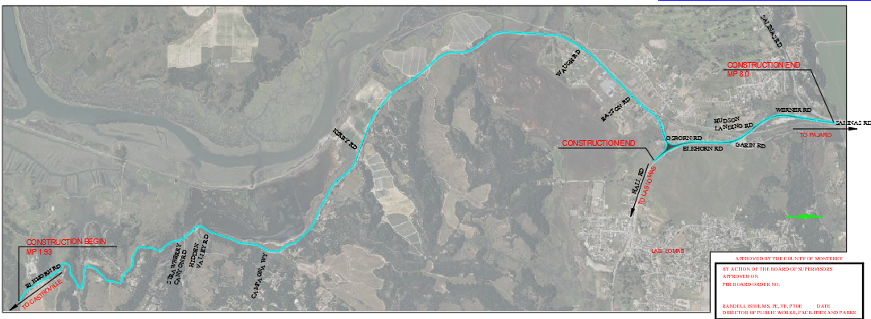
Elkhorn Road Rehabilitation
Previous limits from Hall to Kirby, now Salinas Road and Strawberry
Completion Target Date December 2025
Total project cost: $8.1 million

Slide 35
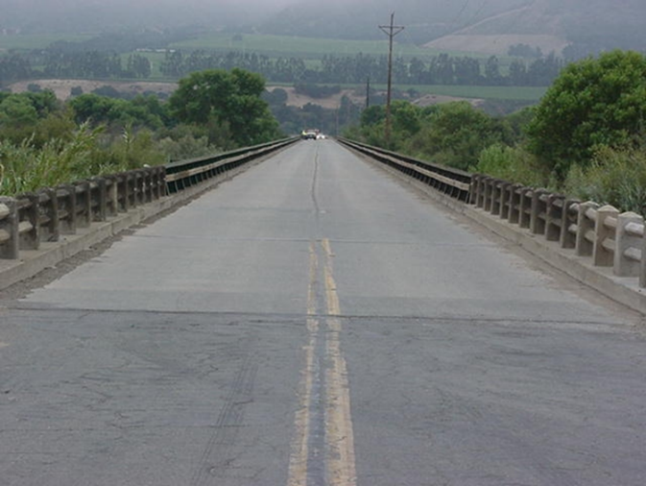
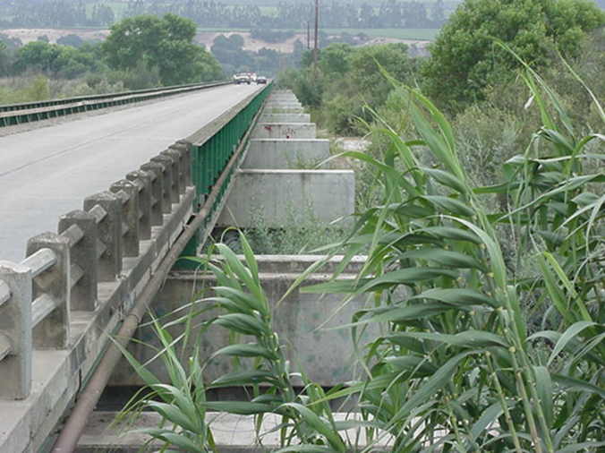
Gonzales River Road Bridge Superstructure Replacement
Replace existing bridge superstructure
FHWA HBMP grant
Total estimated project cost: $16 million
Target construction: 2026
Existing Superstructure
Substructure 2002 Retrofit
Notes:
The project proposes to replace the Gonzales River Road bridge over the Salinas River. The existing bridge is a multi-span bridge that is 1660 feet long and 20 feet wide. The proposed bridge will be 1661 feet and 44 feet wide using the existing substructure that was retrofitted in 2002. The last two spans on the westerly side of the bridge will also need to be replaced to accommodate the 100-year flood flows. The bridge approaches will need to be realigned and widened to match to the new bridge. The project is funded by FHWA HBMP (88.53%) and Measure X provided the local match (11.47%). The project is in the preliminary engineering and environmental documentation phase.

Slide 36
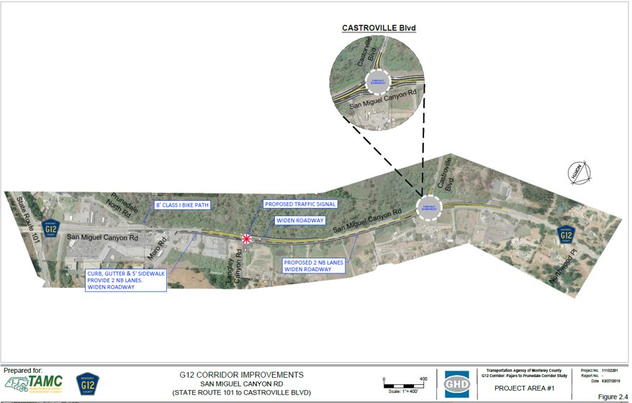
G-12 Corridor Project Segment 1
Construct new roundabout: San Miguel Canyon Road at Castroville Blvd.
HSIP grant
Total estimated project cost: $2.2 million
Start design Summer 2022
Notes:
The project is to install a roundabout at the intersection of San Miguel Canyon Road and Castroville Boulevard in Prunedale. This project a component of the improvements identified in the G-12 Pajaro to Prunedale Corridor Study. The project is in the early preliminary engineering phase. Estimated total cost of the project is $2,189,600. County was the recipient of a Highway Safety Improvement Program (HSIP) grant of $2,189,600 to apply towards project costs.

Slide 37
Project Area 6 of G-12 Corridor Study (Pajaro)
Construct bike and pedestrian safety improvements
HSIP grant funded
Start Construction Summer 2025
Notes:
The project is to install a roundabout at the intersection of San Miguel Canyon Road and Castroville Boulevard in Prunedale. This project a component of the improvements identified in the G-12 Pajaro to Prunedale Corridor Study. The project is in the early preliminary engineering phase. Estimated total cost of the project is $2,189,600. County was the recipient of a Highway Safety Improvement Program (HSIP) grant of $2,189,600 to apply towards project costs.

Slide 38
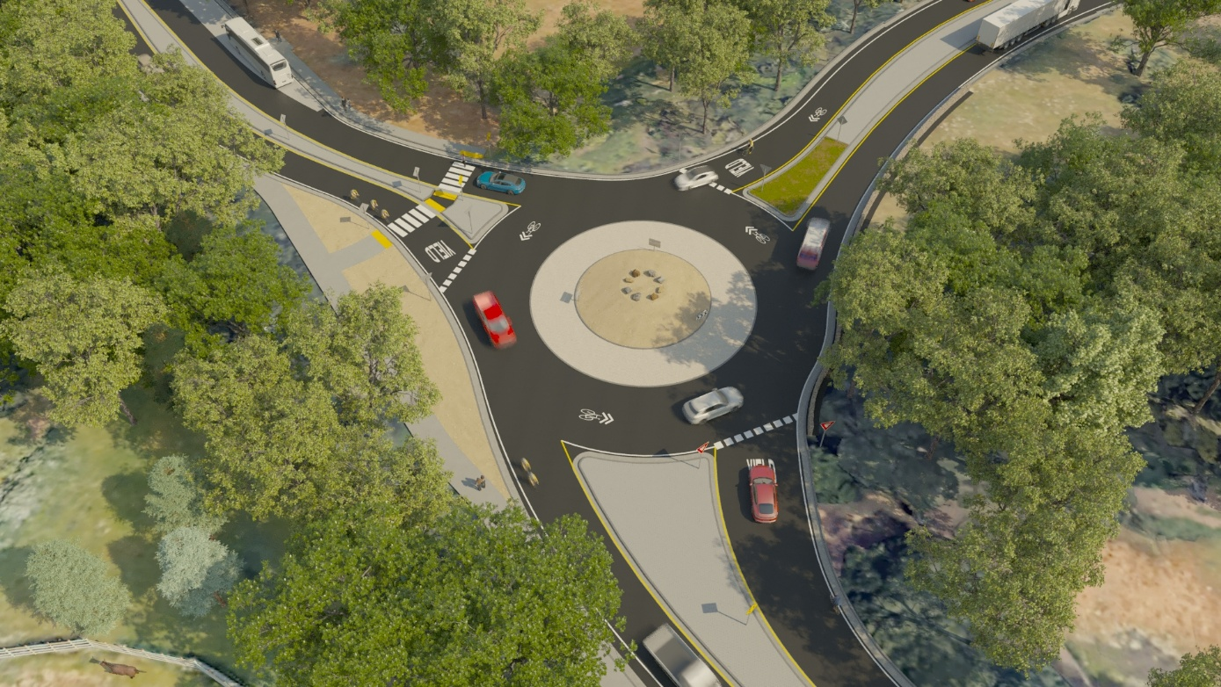
Carmel Valley Road / Laureles Grade Roundabout
Construct new roundabout
Total estimated project cost: $5.4 million
Start Construction Summer 2025
Notes:
The project is to install a roundabout at the intersection of San Miguel Canyon Road and Castroville Boulevard in Prunedale. This project a component of the improvements identified in the G-12 Pajaro to Prunedale Corridor Study. The project is in the early preliminary engineering phase. Estimated total cost of the project is $2,189,600. County was the recipient of a Highway Safety Improvement Program (HSIP) grant of $2,189,600 to apply towards project costs.

Slide 39
Davis Road Bridge Replacement and Road Widening Project
Project Limits: Blanco Road to Reservation Road
Project Elements
All weather crossing over Salinas River
Four-lane Davis Road
Roundabout at Reservation/Davis Intersection
Class II bike lanes along Davis Road
Bus Queue jump lane at Davis Rd/Blanco Rd
Intersection improvements at Foster and Hitchcock
Right-of-way Needs
Easements from 16 parcels along Davis Road needed for road and utility purpose
All easements been appraised and offers presented to owners
Easements secured for most parcels
Negotiating contract language on two remaining parcels

Slide 40
Project Limits
Blanco Road to Reservation Road

Slide 41
Project Status
Project Status.
  Final Design complete
  Project is in the Right-of-way Phase
  Permits have been obtained for the Project
  Gas transmission main relocation complete
Current Items of work
  Coordinating with impacted utility companies
  Negotiating road and construction easements
Schedule
  Fall 2025: Complete R/W phase
  Summer 2025: Overhead utility relocations
  Summer 2026: Start Construction
  Fall 2028: Complete construction

Slide 42
OTHER PLANNED PROJECTS
Continue Pavement reconstruction on Old Stage Road - Design
Carmel Valley Road, 4 lane – Design
Jolon Road – Design and repair
Monte Road Bridge Painting
ATP-grant funded projects in Castroville, Chualar, and San Ardo – in Design
Notes:
Old Stage Road: Iverson to Highway 101, Summer 2022; Design of remainder sections 2022-2023
Hartnell: new bridge $3M, completed Fall 2022
Robinson Canyon Bridge Scour repair: $3 M complete Fall 2022
Toro complete Fall 2022; Viejo Road complete Summer 2023
Castroville Summer 2022 road repair: Crane, Preston Speegle, McDougall, Pomber and Geil Streets (enompases library, NCFD station, NC Park District office, Our Lady of Refuge Church area
Monte bridge construct summer 2024

Slide 43
OTHER PLANNED PROJECTS
Continue Pavement reconstruction on Old Stage Road
Continue Annual Chip Seal Program
Continue Culvert Repair, Guardrail Repair, and Striping programs
Measure X Community Street Repair – Castroville, Boronda, Chualar, and Pajaro
County Service Area and Residential Area Roads
  Local Road Rehabilitation Program v2.0, targeting communities like Bradley, San Ardo, Aromas, Prunedale, Carmel Valley Village, etc.
Continue to pursue State and Federal grants
Notes:
Old Stage Road: Iverson to Highway 101, Summer 2022; Design of remainder sections 2022-2023
Hartnell: new bridge $3M, completed Fall 2022
Robinson Canyon Bridge Scour repair: $3 M complete Fall 2022
Toro complete Fall 2022; Viejo Road complete Summer 2023
Castroville Summer 2022 road repair: Crane, Preston Speegle, McDougall, Pomber and Geil Streets (enompases library, NCFD station, NC Park District office, Our Lady of Refuge Church area
Monte bridge construct summer 2024

Slide 44
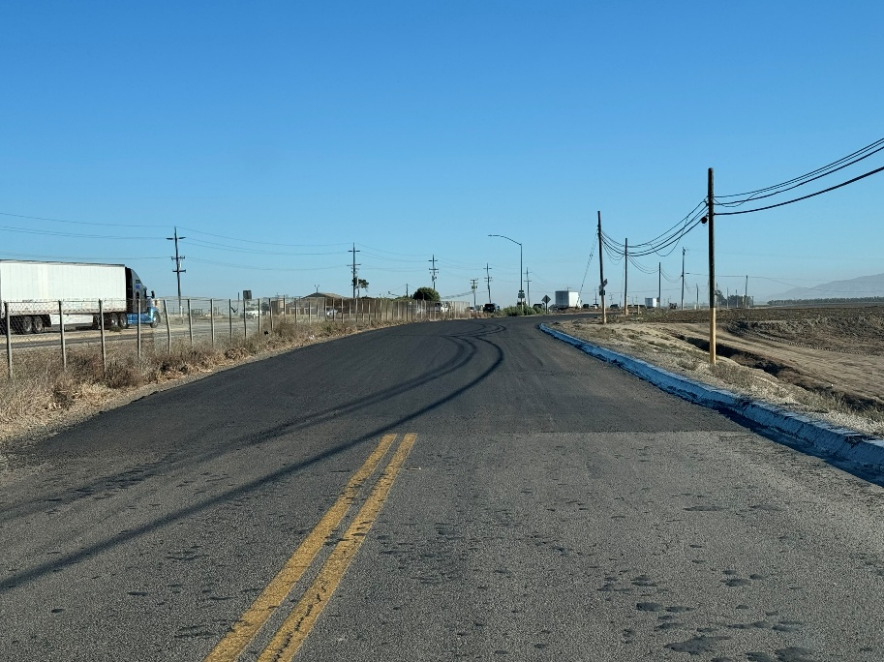
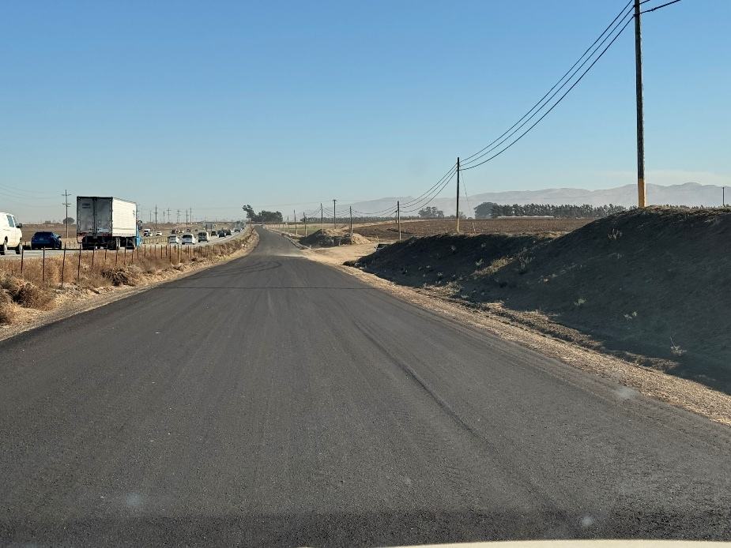
MAINTENANCE EFFORTS
Maintenance “Blade Lay”
Seals all cracks and patched potholes and other defects, leaving a level and stable traveled way for motorists.
This type of work improved the PCI of the road and improved the driving experience.
Notes:
Old Stage Road: Iverson to Highway 101, Summer 2022; Design of remainder sections 2022-2023
Hartnell: new bridge $3M, completed Fall 2022
Robinson Canyon Bridge Scour repair: $3 M complete Fall 2022
Toro complete Fall 2022; Viejo Road complete Summer 2023
Castroville Summer 2022 road repair: Crane, Preston Speegle, McDougall, Pomber and Geil Streets (enompases library, NCFD station, NC Park District office, Our Lady of Refuge Church area
Monte bridge construct summer 2024

Slide 45
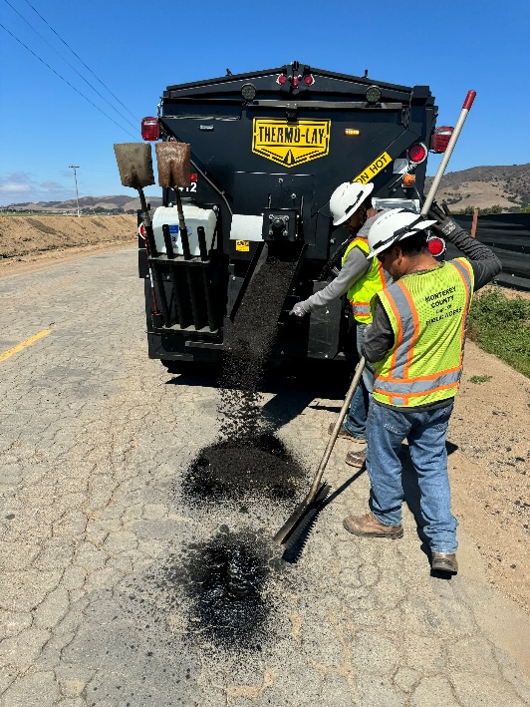
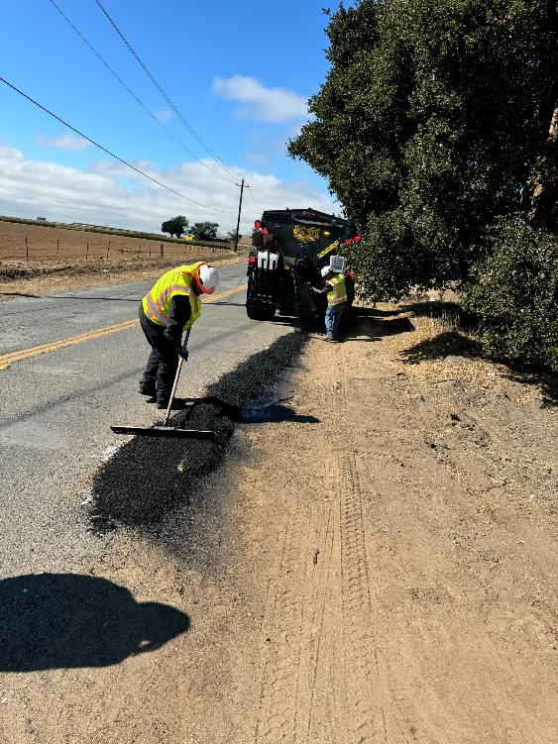
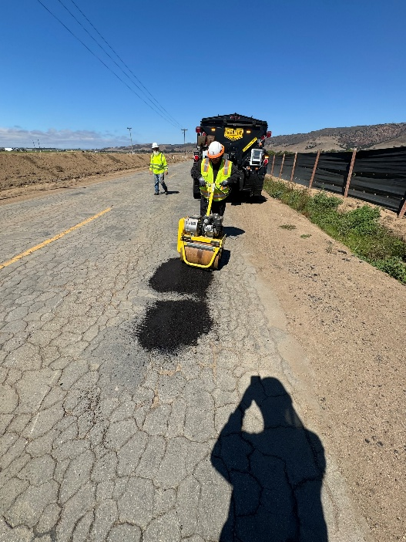
MAINTENANCE EFFORTS
Hot Truck
  Past method has been to use “cold mix” for pothole repairs.
  Hot truck patches potholes using Hot Mix Asphalt (HMA)
  Same material we use for repaving roads or new roads.
  More durable and longer lasting
Notes:
Old Stage Road: Iverson to Highway 101, Summer 2022; Design of remainder sections 2022-2023
Hartnell: new bridge $3M, completed Fall 2022
Robinson Canyon Bridge Scour repair: $3 M complete Fall 2022
Toro complete Fall 2022; Viejo Road complete Summer 2023
Castroville Summer 2022 road repair: Crane, Preston Speegle, McDougall, Pomber and Geil Streets (enompases library, NCFD station, NC Park District office, Our Lady of Refuge Church area
Monte bridge construct summer 2024

Slide 47
Contact Information for Road Issues
Email: 300-servicerequest@co.monterey.ca.us
Call: (831) 755-4925
MoCoConnect app

Slide 48
Measure X Citizen Oversight Committee
April 15, 2025
Agenda Item No. 4
Questions or Comments?

