Slide 1
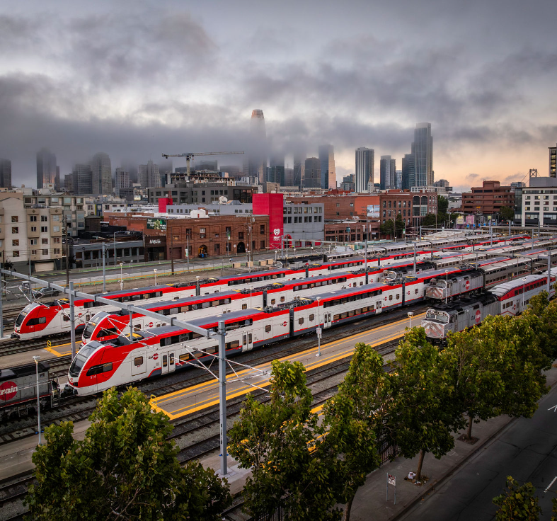

Salinas Extension:
Caltrain Updates
Sam Sargent, JD, AICP
Director, Strategy & Policy
Caltrain
TAMC Rail Policy Committee

Slide 2
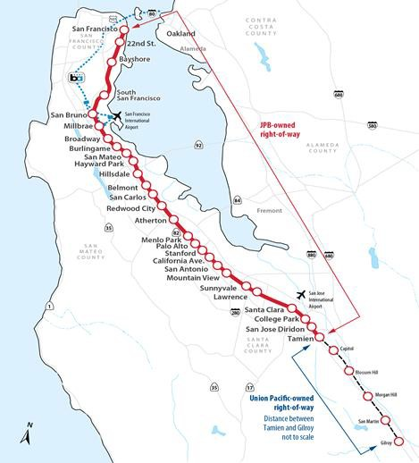
Caltrain Overview
Current Operation:
77 miles of track from San Francisco to Gilroy: 51 miles owned by Caltrain, 26 miles by Union Pacific
31 stations (3 counties, 20 cities)
104 trains per day weekday, 64 trains weekend
  4 morning, 4 evening trains weekdays to Gilroy
41 at-grade crossings
Blended System for future Northern California HSR
Tenant Railroads: ACE, Amtrak, Capital Corridor, UP

Slide 3

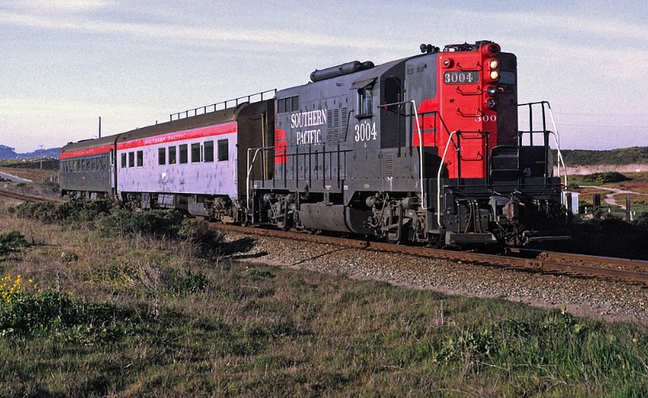

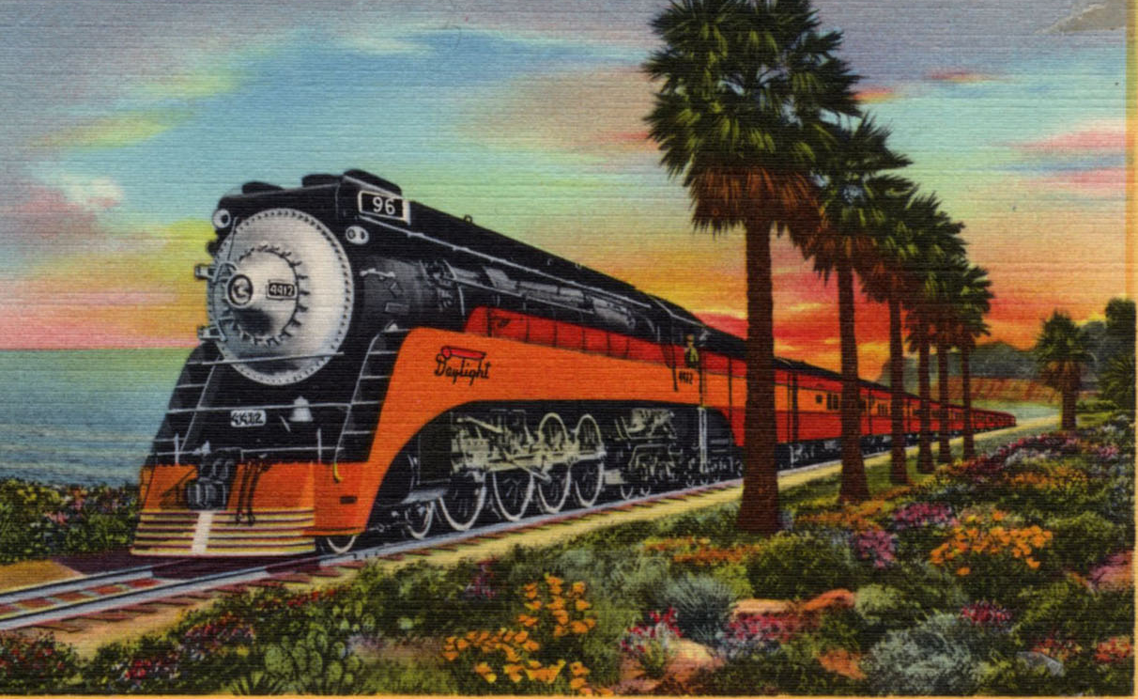
Salinas Extension History
INSTRUCTIONS
Gilroy – Salinas Extension Concept
Southern Pacific provided service (Del Monte) between Monterey and San Jose via Castroville and Watsonville from 1889 to 1971.
Southern Pacific’s Coast Daylight served Salinas until 1974, and Amtrak’s Coast Starlight has served Salinas since.
Gilroy – Salinas commuter rail extension has been considered in a variety of previous studies:
  2022 California State Rail Plan
  Caltrain Business Plan (2040 Service Vision)
  Monterey Bay Area Network Integration Study

Slide 4
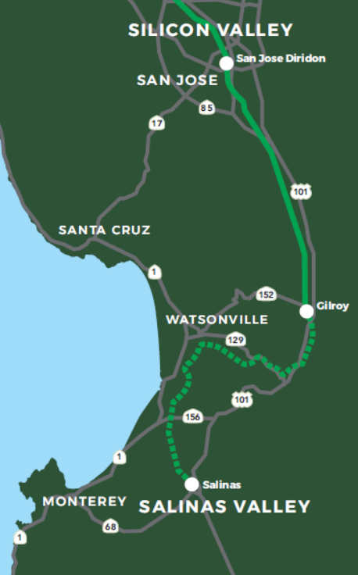
Caltrain – TAMC MOU
INSTRUCTIONS
Gilroy – Salinas Feasibility Study
In 2020, Caltrain and TAMC partnered on the Gilroy-Salinas Feasibility Study, which further explored extending service from the current Caltrain southern terminus at Gilroy into Monterey County.
The study was predicated on four critical principals:
  Service extension must be cost-neutral for Caltrain
  No changes to Caltrain mainline service
  Monterey County assumes all risks and liabilities of service extension
  Service extension makes no changes to the JPB governance structure

Slide 5
Salinas Rail Extension – Plan to Operation
INSTRUCTIONS
Next Steps
Incorporation of the Salinas Extension into Caltrain’s re-bid of the railroad’s Operations and Maintenance contract.
  2027
$80 million in state funding secured for a battery electric hybrid vehicle, designed and built by Stadler US in Salt Lake City. Same as current electric trains.
  2028
Continued coordination between Caltrain, CalSTA, and TAMC on operations planning and a second agreement for the future service.

Slide 6
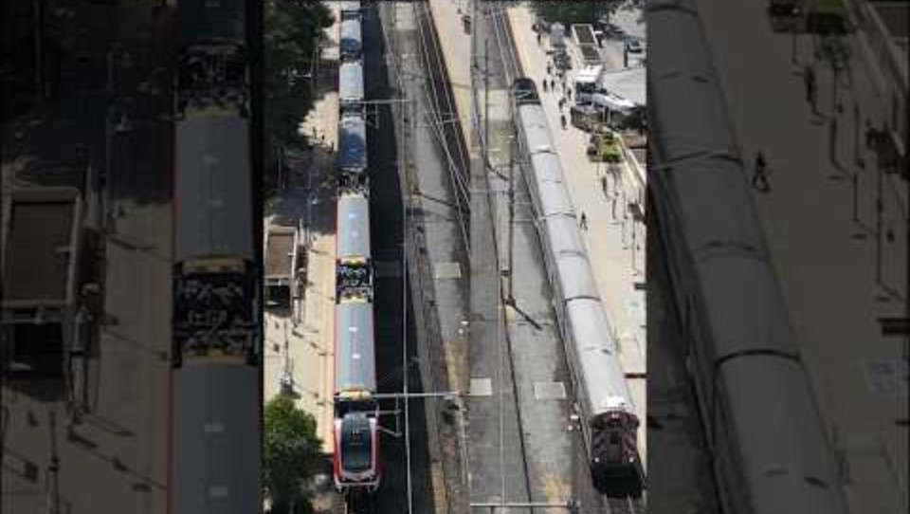
Salinas Rail Extension – Plan to Operation
INSTRUCTIONS
Next Steps

Slide 7
Salinas Extension:
Caltrain Updates
Sam Sargent, JD, AICP
Director, Strategy & Policy
Caltrain
TAMC Rail Policy Committee

