Slide 1
Fort Ord Regional Trail and Greenway California Avenue Segment: Final Design and Right-of-Way Contract
Transportation Agency for Monterey County
August 23, 2023
Notes:
ID=d924773e-9a16-4d6d-9803-8cb819e99682 Recipe=text_billboard Type=TextOnly Variant=0 FamilyID=AccentBoxWalbaum_Zero

Slide 2
Agenda
Background
Project Details
Timeline
Staff Recommendation

Slide 3
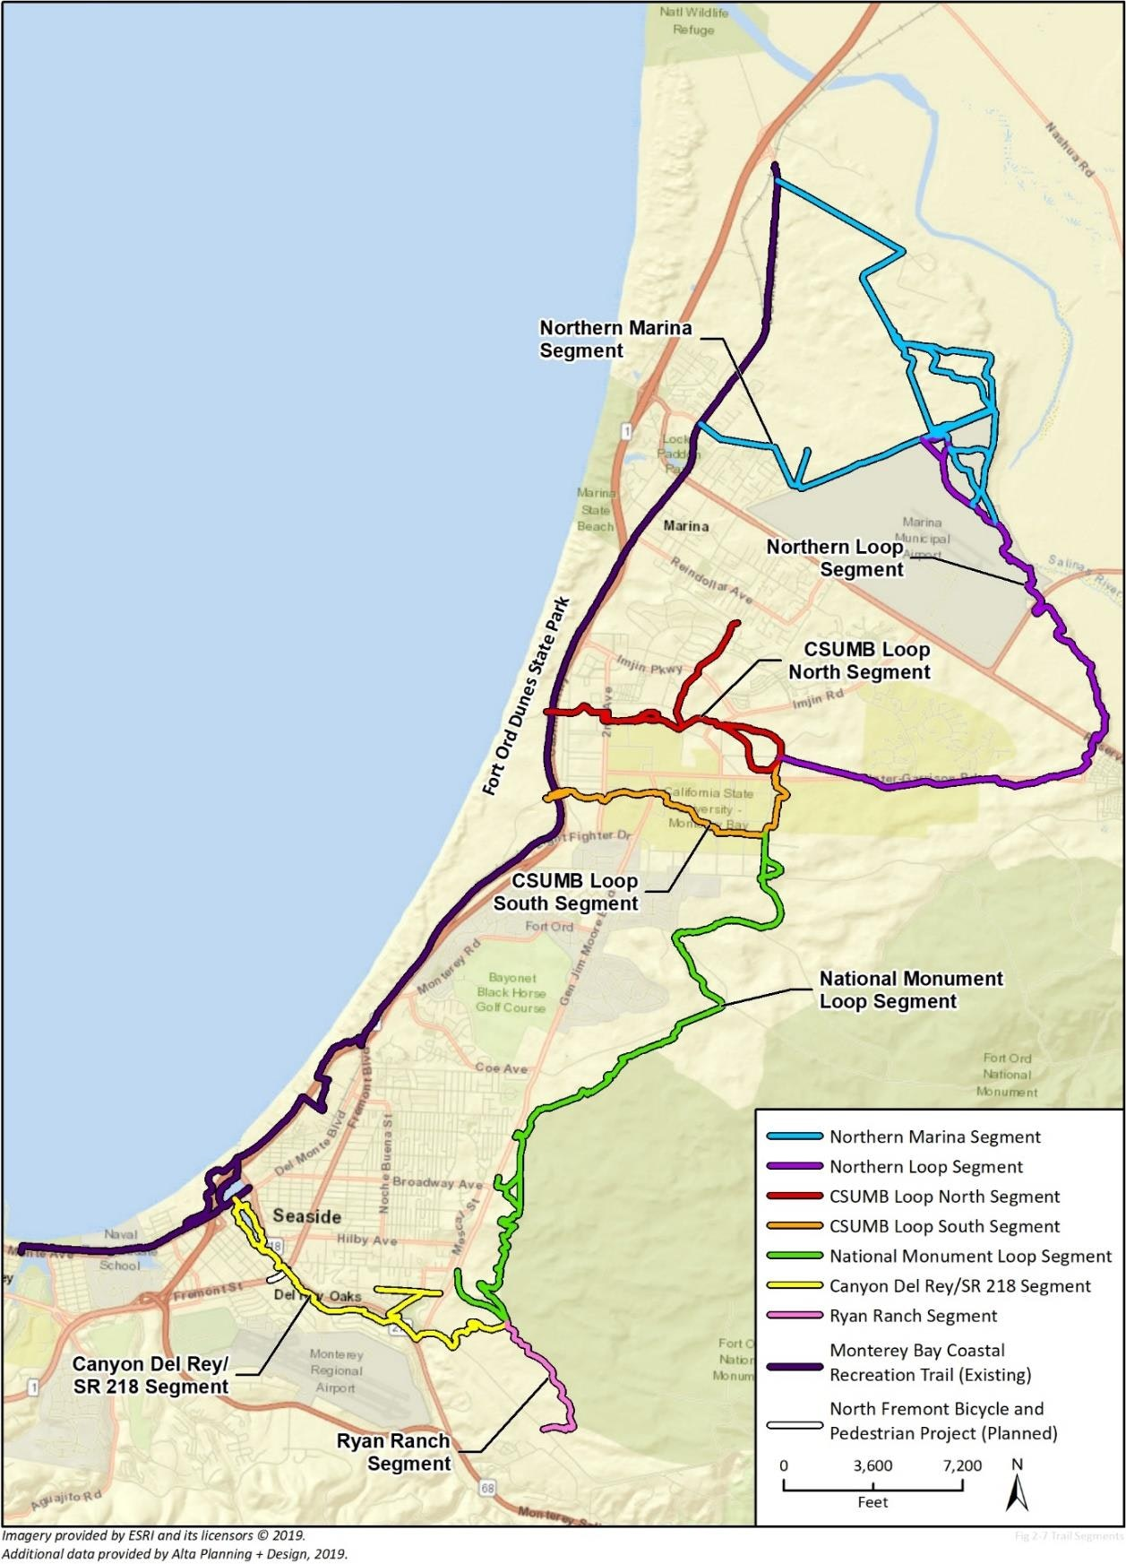
Background
Fort Ord Regional Trail and Greenway (FORTAG) is proposed as an approximately 28-mile continuous 12-ft wide paved bicycle and pedestrian trail with an open-space buffer on both sides.
The vision for FORTAG is that it facilitates active transportation - expanding our region's opportunities for traveling between home, work, and commercial areas by foot, bike, or wheelchair.

Slide 4
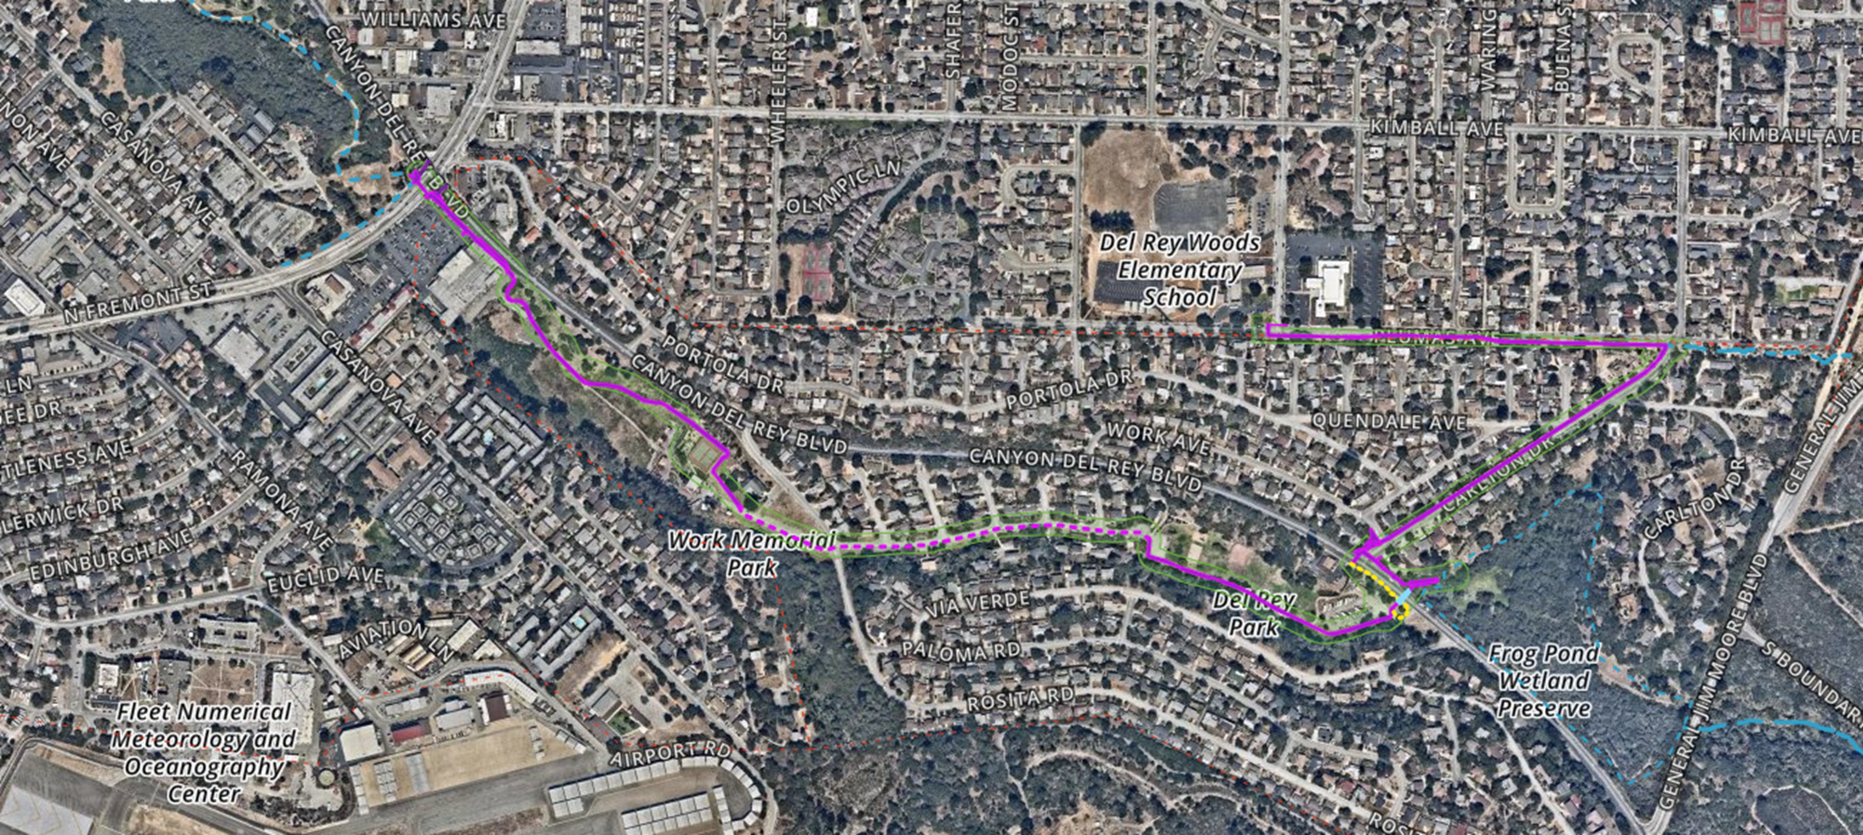
FORTAG Segment 1: Canyon Del Rey
Funded with Active Transportation Program (ATP), SB 1 Local Partnership Formula (LPP), and Measure X
Total project cost: $13.6 million
Construction FY 22/23

Slide 5
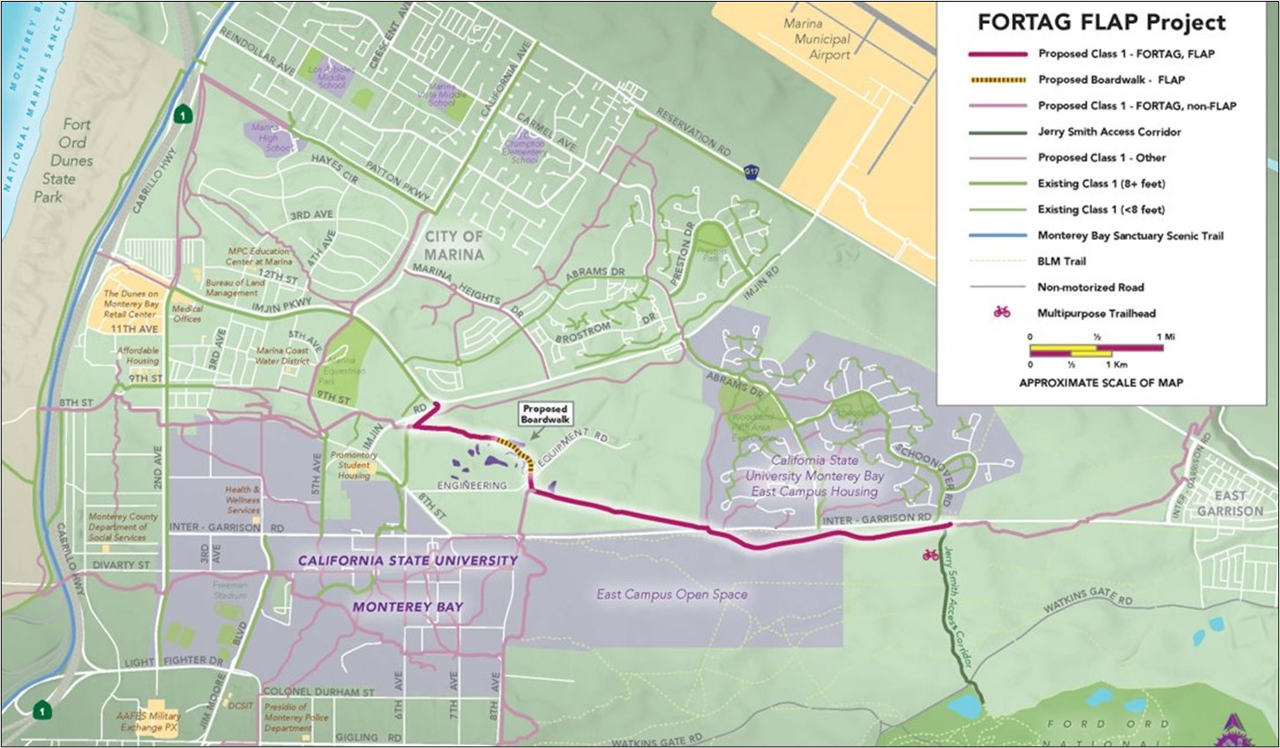
FORTAG Segment 2: Imjin Road to Jerry Smith Trailhead
Funded with Federal Lands Access Program (FLAP) and Measure X
Total project cost: $12.2 million
Construction FY 26/27

Slide 6
FORTAG Segment 3: California Avenue
Awarded $8.1 million Active Transportation Program (ATP) Cycle 6 grant in 2022
Final Design and Right of Way Request for Proposals approved by TAMC Board in March 2023
GHD, Inc. selected for contract negotiations in July 2023

Slide 9
Project Details
1.4 mile 12-foot paved multi use path
Accessible sidewalk improvements north of Patton Pkwy connect Marina schools to the multiuse path
Protected intersection at California Ave and Imjin Pkwy
Bicycle and pedestrian overcrossing at Imjin Rd connects to FORTAG Segment 2
Safe Routes to School programming

Slide 10
Timeline
March 2023
TAMC Board approved Final Design and ROW Request for Proposals
August 2023
TAMC Board Approve Contract with GHD, Inc.
September 2023
Begin Final Design and ROW
May 2025
Begin Construction
October 2026
End Construction
FORTAG California Avenue Segment: Final Design and ROW

Slide 11
Staff Recommendation
APPROVE and AUTHORIZE the Executive Director to execute a contract with GHD, subject to approval by Agency Counsel and Caltrans' Independent Office of Audits and Investigations, for an amount not to exceed $2,272,508, which includes a 10% contingency, to provide final design and right of way certification services for the FORTAG California Avenue Segment, for the period ending June 30, 2026; and
APPROVE the use of State Active Transportation Program and Regional Measure X funds budgeted for this project;
AUTHORIZE the Executive Director to take such other further actions as may be necessary to fulfill the intent of the contract, including approval of future modifications or amendments that do not significantly alter the scope of work, or change the approved contract term or amount.
FORTAG California Avenue Segment: Final Design and ROW

Slide 12
Thank you
Janneke Strause, Transportation Planner
Janneke@tamcmonterey.org
www.tamcmonterey.org/
fort-ord-regional-trail-greenway
FORTAG California Avenue Segment: Final Design and ROW

